Slide 1
UBC Education Library
Activity report 2018-2019
~
Supporting Teacher Librarianship and the
School Library Learning Commons
Peggy Lunn, Wendy Traas, Emily Fornwald

Slide 2
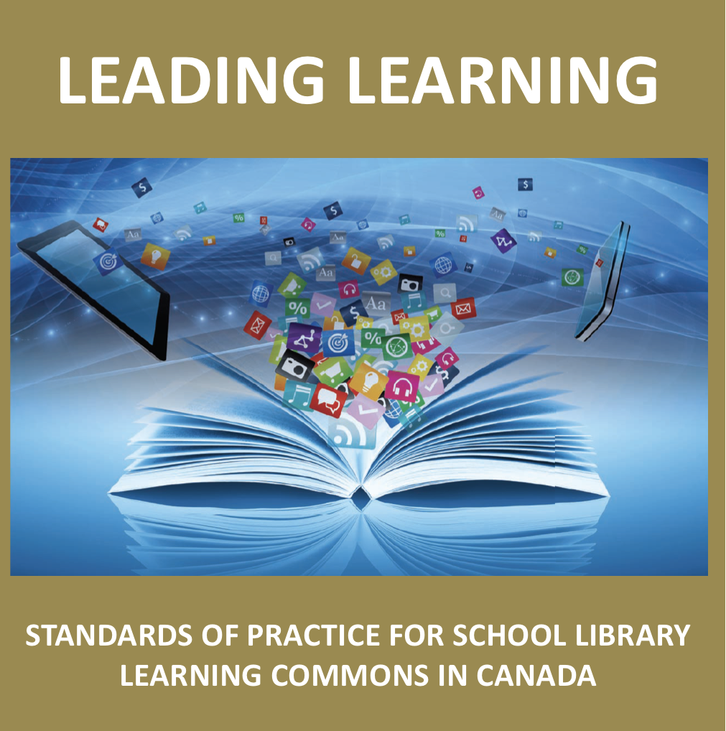
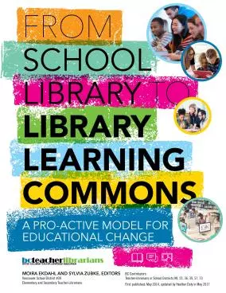
Goal i) To grow visibility and authority of Canadian School Libraries, Leading Learning ii) To grow visibility and authority of BCTLA, and its publications Target(s) UBC Faculty of Education, UBC iSchool Strategy i) Visibility ( print documents available and included everywhere ) ii) Amplification through Contextualization ( social media framing ) iii) Repetition, Consistency (every transaction is an opportunity ) Assessment Strategy / Outcomes .... Under construction
Activity Showcasing lead bodies/documents in Canadian School Librarianship

Slide 3
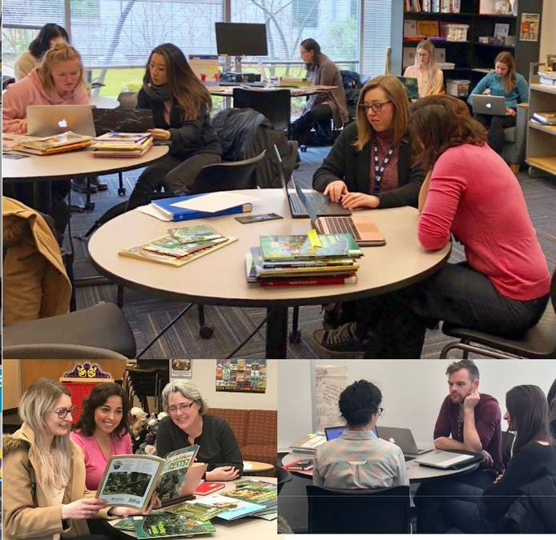
Goal Teacher Candidates graduate the UBC B.Ed program with a core belief that the LLC and Teacher Librarians are an integral part of educational practice and the life of a school. Target(s) UBC Faculty of Education: Elementary, Middle Grades, Secondary Candidates, and Faculty Strategy i) Intentional inclusion in workshops, orientations, supporting documentation ii) Amplification through Contextualization ( Social media, Branch Instructional program, Authorfest ) iii) Repetition, Consistency
Activity Including School Libraries in the Ed Library’s Instructional Program

Slide 4
Goal i)Create opportunity for ‘professional collisions’ ii)Showcase the LIBE program at UBC LLED Target(s) UBC Library, UBC Faculty of Education, UBC iSchool, Local Educator community, General Public Strategy Co-hosted a celebratory event at UBC in recognition of Canadian School Library Day, Monday Sept 22, 2018 Speakers from variety of settings, display of resources, catering, informal mingle environment Outcome Participants & Attendees: 3 UBC Librarians, 1 VIU Librarian, 2 TLs, 4 iSchool students, 2 iSchool Faculty, I SFU Education student, 1 VPL Children’s Librarian, 3 UBC Ed Faculty members, 2 general students,1 Science World Outreach programmer Timing ☹
Activity Acknowledge Canadian National School Library Day

Slide 5
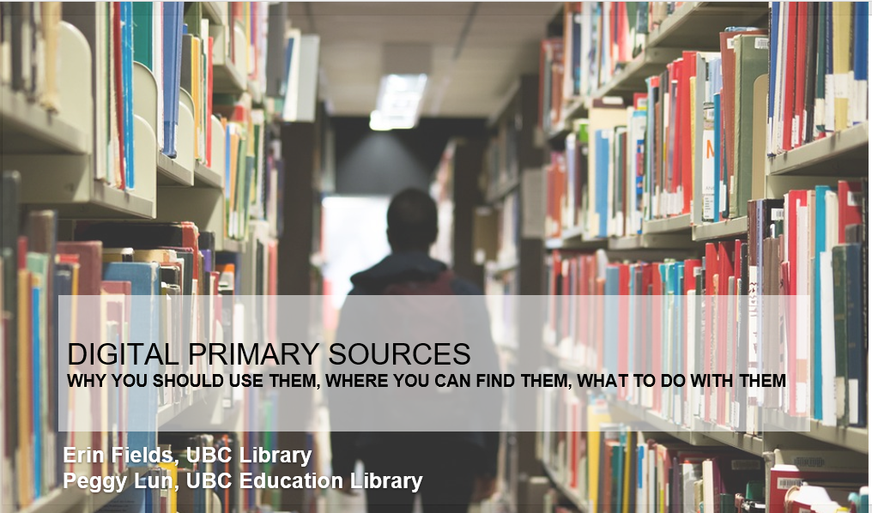
Goal i)To share the findings of research project on teacher use of UBC Open Collections ii)To encourage strategic thinking by TL community about digital primary resource use iii)To showcase UBC Open Collections with links to BC Curriculum iv)To provide examples of classroom activities that went beyond pasting into PPT Target(s) BC Teacher Librarians, District Co-ordinators, any other co-horts present Assessment strategy Admission & Exit Tickets, additional comments Outcome TLs bought in conceptually, want access to collections made easier, want more training, want support for co-teaching, do NOT like passive PD sessions ☺
Activity BCTLA – Challenge Accepted

Slide 6
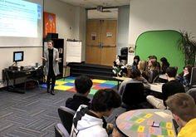
Goal i)To reframe the traditional secondary school University Library visit. ii)To grow relationships with local Educators, centring the TL as colleague Iii)To broaden/update S & TL perceptions of the post secondary information & learning environment Target(s) Secondary School educators Strategy ½ day learning opportunities for secondary students in Grades 11 or 12 through co-ordination with school based Teacher Librarians. November, December and May. https://wiki.ubc.ca/Library: Education_Library_Learning_Opportunities
Activity Custom, co-planned ½ day learning sessions – Emily Fornwald

Slide 7
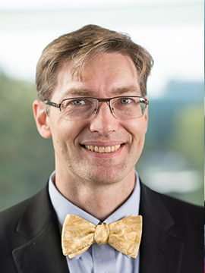
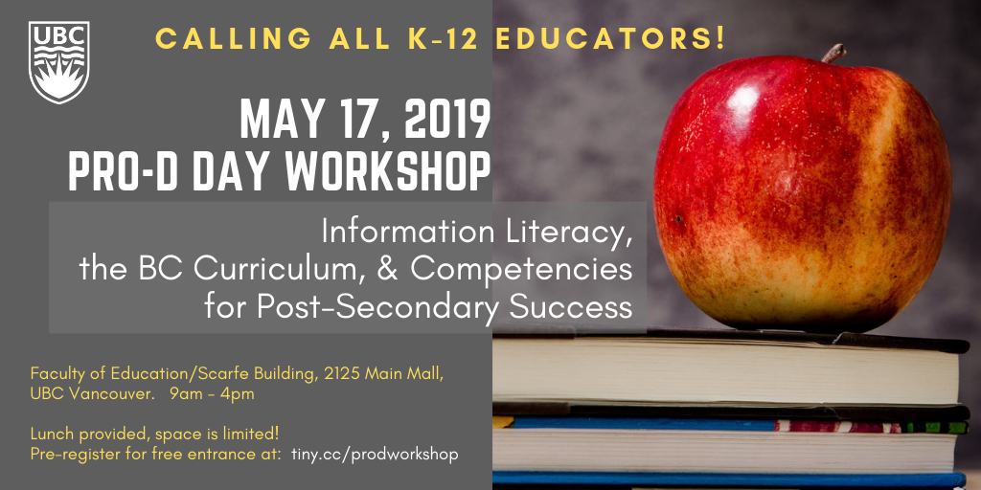
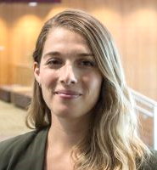
Activity
Advancing the literature
Dr. Eric Meyers, Associate Professor, UBC iSchool
Wendy Traas,
Education Librarian
UBC Library
Alex Kuskowski
Learning Services Librarian
UBC Library
Notes:
There are a few spots remaining for a free, full day Pro D workshop at the UBC Faculty of Education on Friday, May 17. Please join us!
In this workshop we will introduce the Association of College & Research Libraries’ Framework for Information Literacy for Higher Education and it’s connection to the BC curriculum. Together, we will explore the connections between inquiry-based learning in the K-12 context and the information literacy skills that students need to be successful in post-secondary contexts. What are the core competencies and “big ideas” for post-secondary inquiry, and how do these connect to the BC curriculum? What tensions and opportunities do these ideas raise for students and educators? Through this interactive, design-based workshop you will collaboratively develop learning opportunities to support the development of information literacy skills that align with the BC curriculum and prepare students for the post-secondary learning environment. At the conclusion to the workshop, participants will be invited to use TeachBC to share their learning plans with other educators, and find additional resources to support inquiry practice.
There are a few spots remaining for a free, full day Pro D workshop at the UBC Faculty of Education on Friday, May 17. Please join us!
In this workshop we will introduce the Association of College & Research Libraries’ Framework for Information Literacy for Higher Education and it’s connection to the BC curriculum. Together, we will explore the connections between inquiry-based learning in the K-12 context and the information literacy skills that students need to be successful in post-secondary contexts. What are the core competencies and “big ideas” for post-secondary inquiry, and how do these connect to the BC curriculum? What tensions and opportunities do these ideas raise for students and educators? Through this interactive, design-based workshop you will collaboratively develop learning opportunities to support the development of information literacy skills that align with the BC curriculum and prepare students for the post-secondary learning environment. At the conclusion to the workshop, participants will be invited to use TeachBC to share their learning plans with other educators, and find additional resources to support inquiry practice.

Slide 8
Activity Researching the practice
http://tmc.canadianschoollibraries.ca/

Slide 9
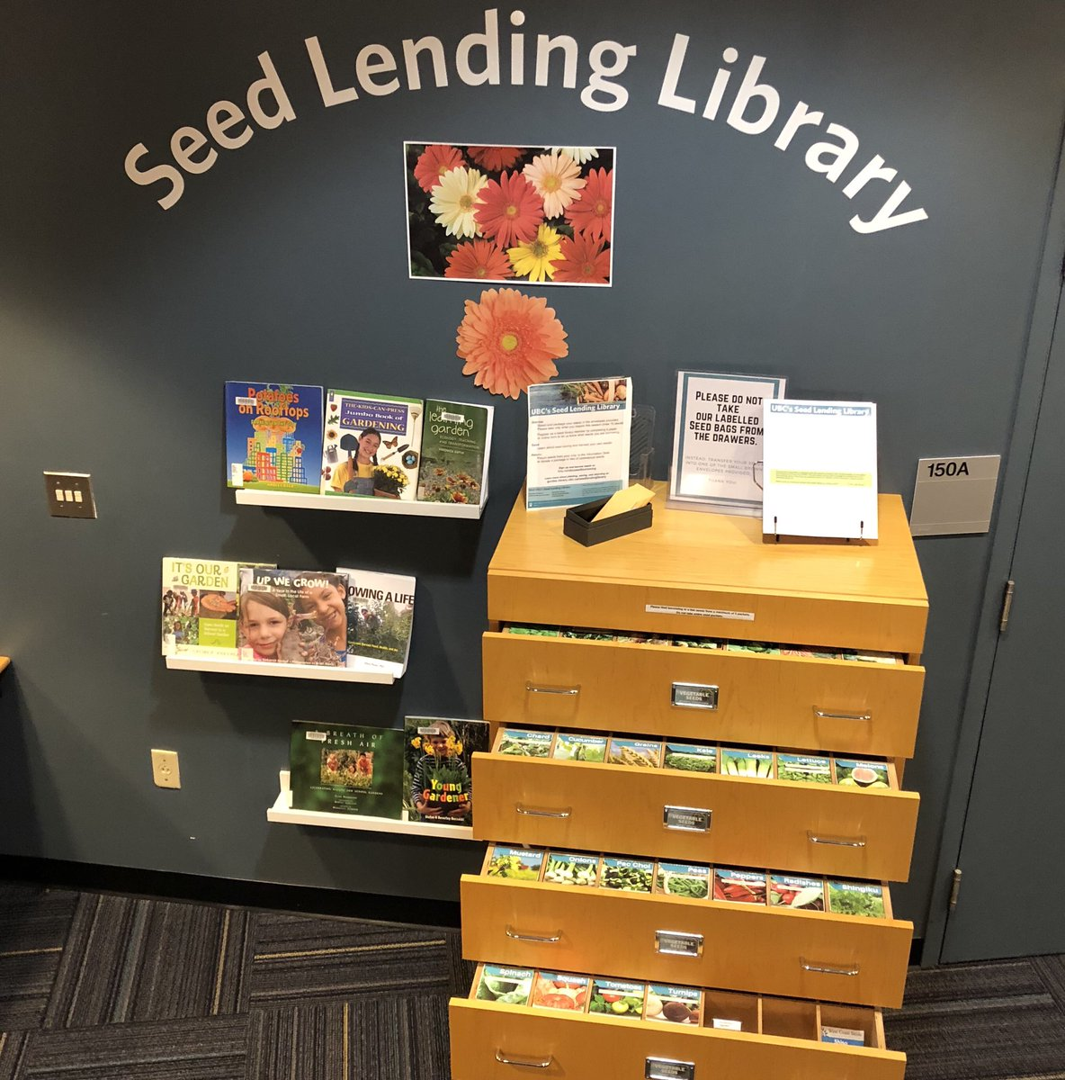
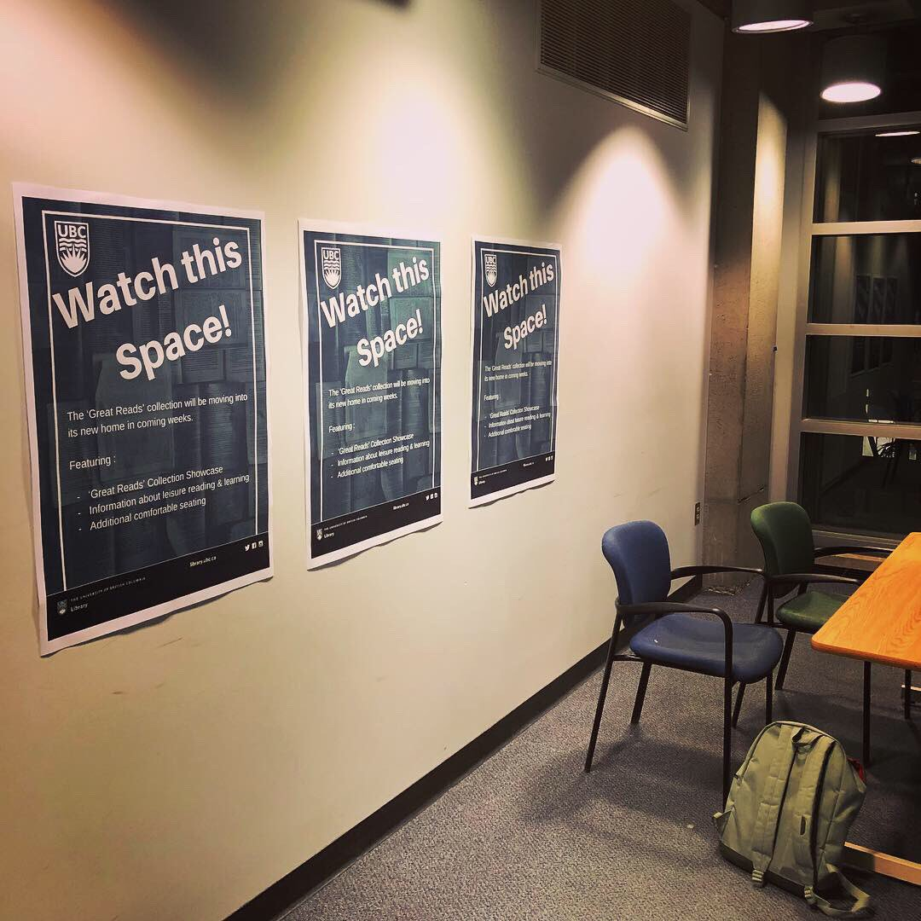
Other activities ....
Faculty of Education Community Field Experience
Young Learners Library - Continuing to develop...
UBC Seed Lending Library – 3 years and growing...
UBC Great Reads Collection - Under Construction...

Slide 10
Things we’re thinking about ....
Instructional Program How can we showcase the role of the TL and the LLC in inquiry based teaching & learning environments. Assessment
i)Within/ through/ of our teaching practices and activities
ii)Incoming perceptions vs. Outgoing perceptions of Teacher Librarianship and the LLC
Contextualizing ‘Problematic’ Children’s Literature
AKA What do we do with all the racist books ? BCTLA Summer Institute Would you like us to host one? On what?

Slide 11
Things you’re thinking about...
Is there something UBC Education Librarians
are uniquely positioned to do
with / for / about
Teacher Librarianship, School Libraries, Learning Commons
peggy.lunn@ubc.ca

Slide 12
Thank you

