Slide 1

ESSENTIALS
FOR SCHOOL
LIBRARIES
L. Caine
October 2024
BCTLA Conference
Victoria, BC

Slide 2

Land Acknowledgement
In the spirit of truth and reconciliation I acknowledge and thank the Lkwungen People, also known as the Songhees and Esquimalt First Nations communities for their stewardship on these lands since time immemorial and I commit to the process of decolonization.
Notes:
Le-qe-won-en

Slide 3
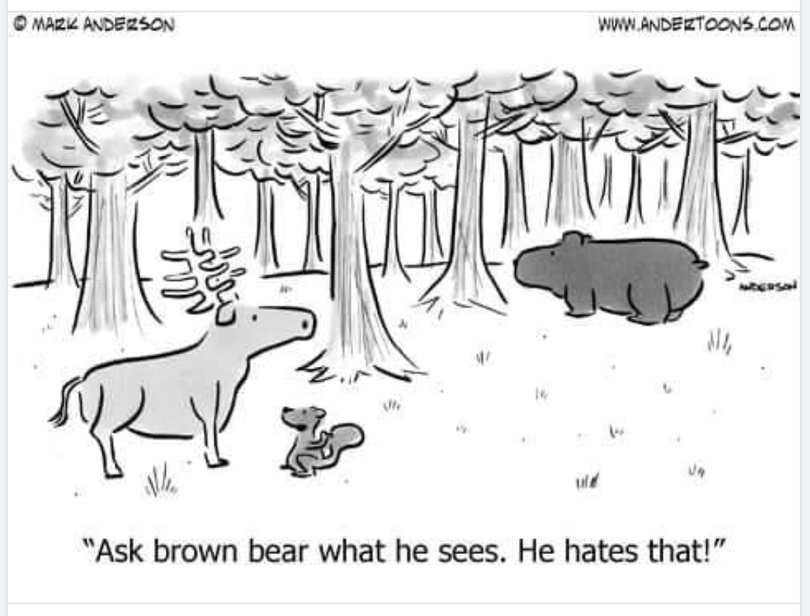
TL HUMOUR
Notes:
Le-qe-won-en

Slide 4

WELCOME!
School librarians are often overwhelmed with both leadership, management and teaching tasks. It seems there is never enough time. Creating a library mission statement offers a partial solution to this issue. Consistently referring back to it when decisions regarding how time is spent are made will help to ensure that suitable time is spent upholding the truly important values, thus allowing service to students to be the focus.
Notes:
Introduce myself and then share this info. This was not in the session description, but is an essential component of a school library.

Slide 5
Create a library mission statement
1
2
3
4
Determine your core values
Set standards
Know school goals
Weave in District mission statement language
Notes:
Here are the four steps in creating a mission statement.

Slide 6

Core Values
Notes:
What are your core values? Yes, most of us value all of the above. But go through them and rank your top 3 or 4.

Slide 7


Canadian School Libraries Standards (CSL)
International Society for Technology in Education Standards (ISTE)
Notes:
Create standards for your library based on your core values. Here I linked the school district standards as well as the Canadian School Library Standards and ISTE standards.

Slide 8

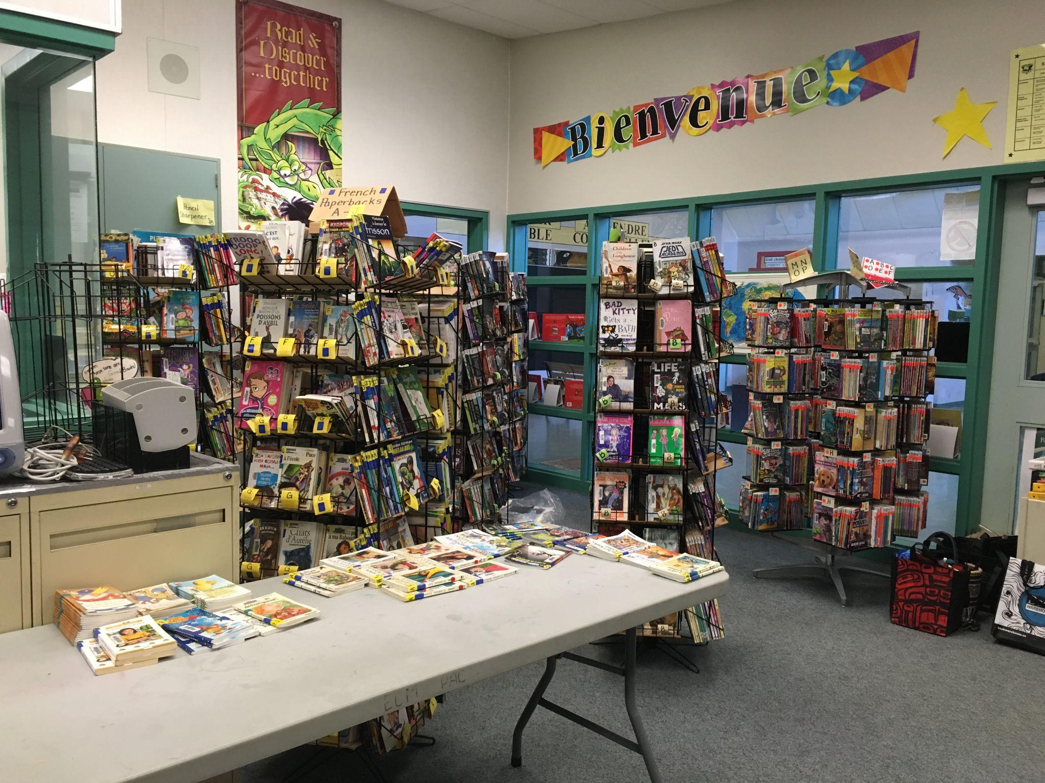
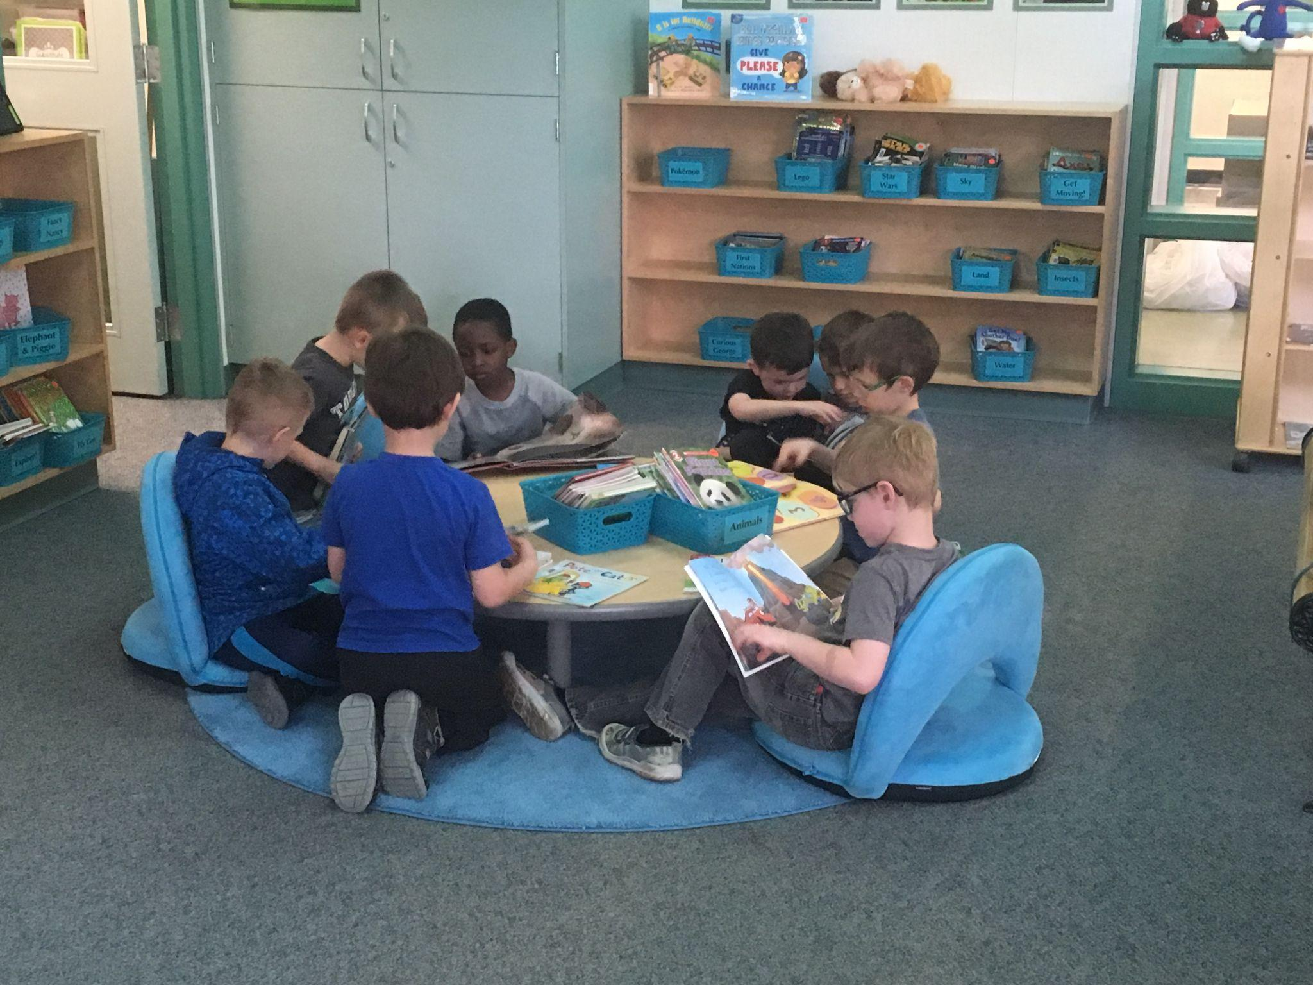
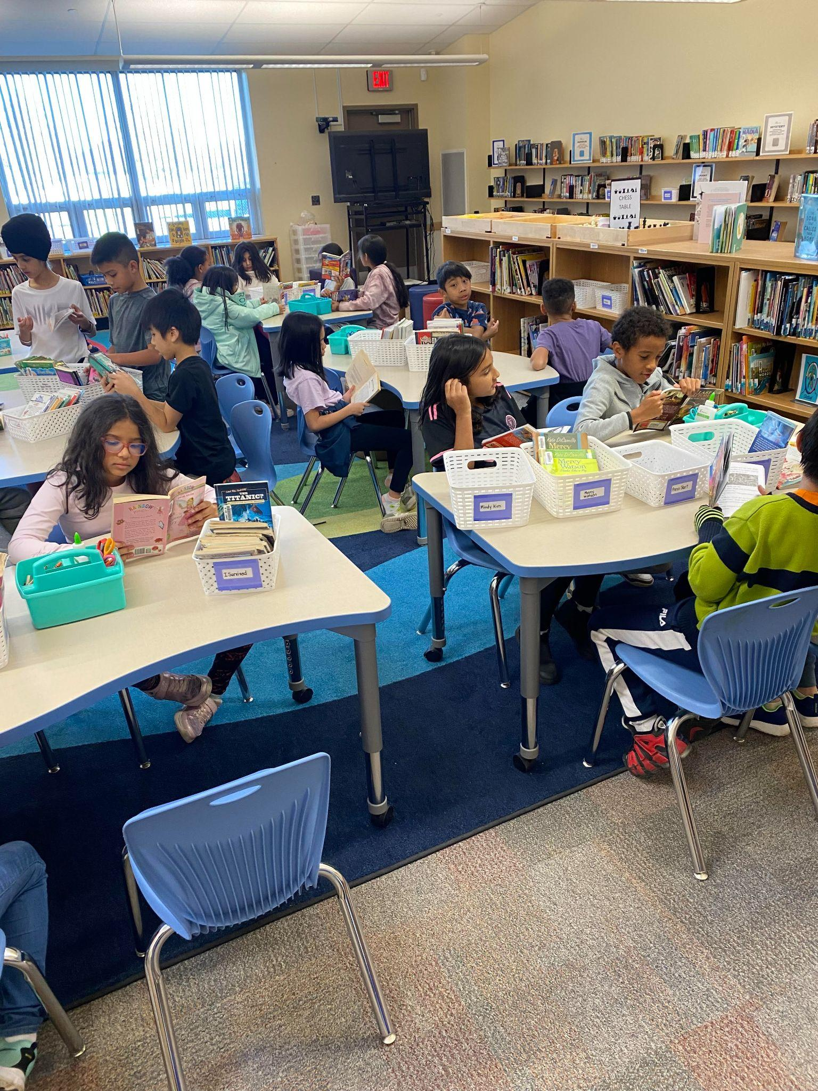
My mission statement is a Northstar for me as I journey through the school year and choose where and how to spend my time and funds. For me, a nonnegotiable is creating a welcoming environment. I have seen over and over again how valuable the library is as a place of refuge for a variety of reasons for a variety of students. I wouldn’t prioritize my instructional practices or my information literacy skills practices over making the students feel welcome and encouraging their love of reading.
Before
After
Watch video

Slide 9

School librarians are often overwhelmed with both leadership, management and teaching tasks. It seems there is never enough time. Creating a library mission statement offers a partial solution to this issue. Consistently referring back to it when decisions regarding how time is spent are made will help to ensure that suitable time is spent upholding the truly important values, thus allowing service to students to be the focus.
Notes:
Read through this. Tell participants to set their goals: 1. A collection goal: diversification, weeding, genrefying. 2. An instructional goal: create a scope and sequence, try inquiry, tech goal: teach students and staff about Canva.

Slide 10
ROUTINES
Circulation
Holds
Monthly Themes
Repairs
TTOC Binder
Advocacy
Notes:
In the description of my presentation, I referred to routines for the following: circulation, holds, monthly themes, managing repairs, a TTOC binder, and advocacy ideas/

Slide 11
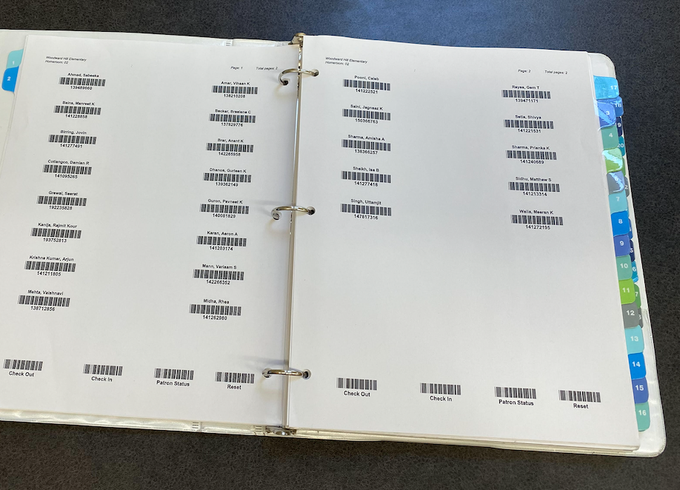
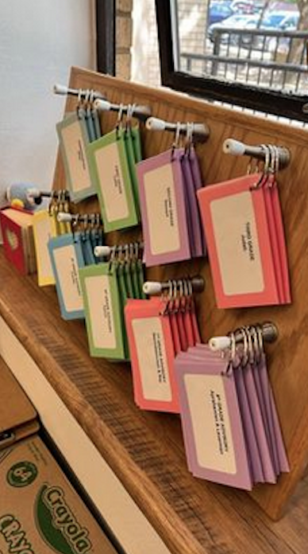
CIRCULATION
Primary Students: At the beginning of the year make library cards/shelf-markers for each student. Print and attach barcodes. Decorate. Laminate.
Store in division groups.
Intermediate Students: As above only use index cards or use binder divided by division with pictures.
Cards can be reused for several years by adding coloured dots to indicate new divisions.
Notes:
I always laminate extra blank cards for students who transfer in during the year. Saves having to do laminating. Used to use construction paper-but it is now so thin that the cards do not function well as shelf markers. Optional to use tag or to have other items as shelf markers. Why cards? They are fast! Kindergarten students who whisper or don’t know their name. I can quickly see who still has their card and offer assistance in making a book choice. It helps with name recognition for K’s. I sometimes scan them ahead of a class’s arrival to see who has/has not brought back their books, as students often do not know. Laminated index cards, hole punched and organized by grade on a board.

Slide 12
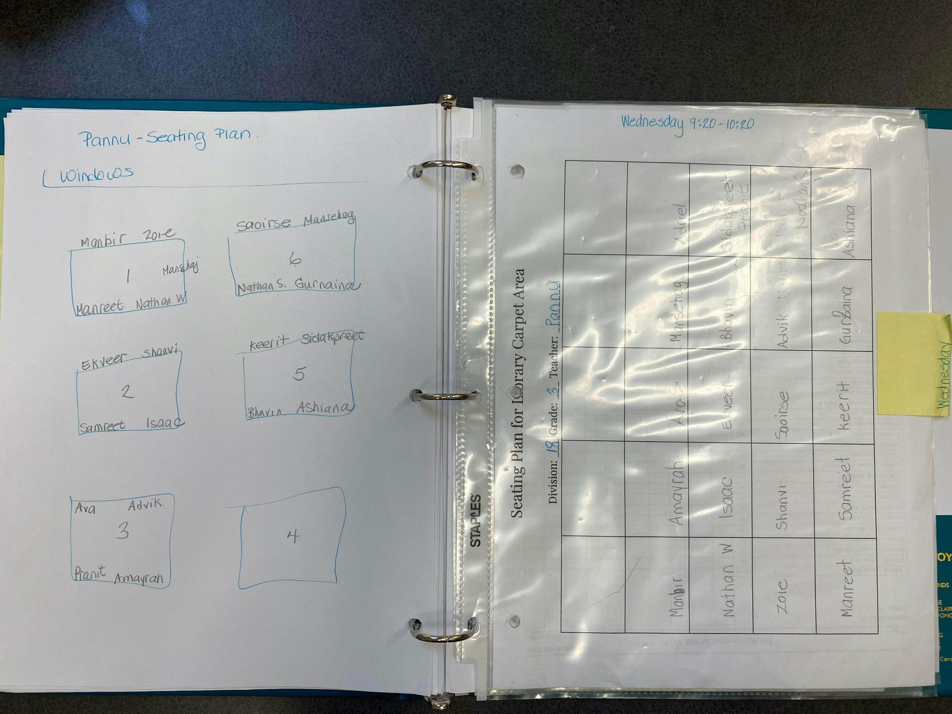
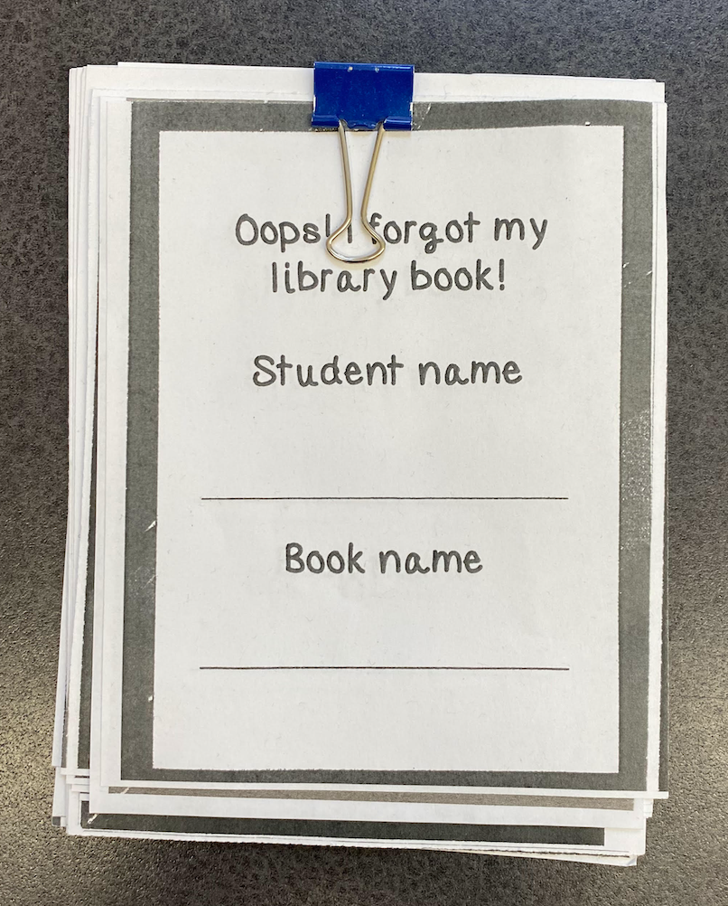
CIRCULATION
One table at a time chooses their books.
A recent development is that I have carpet seating plans and table seating plans.
Students don’t have to stress about seating.
I am able to separate certain individuals.
Less chaotic.
I saw online one TL that asks classroom teachers to create a seating plan for the library.
Students take their books back to their tables and either read or do the activity.
Students who have forgotten their books, choose a book to look at while it is book choosing time.
Notes:
SEL regarding not having to decide who to sit with.

Slide 13
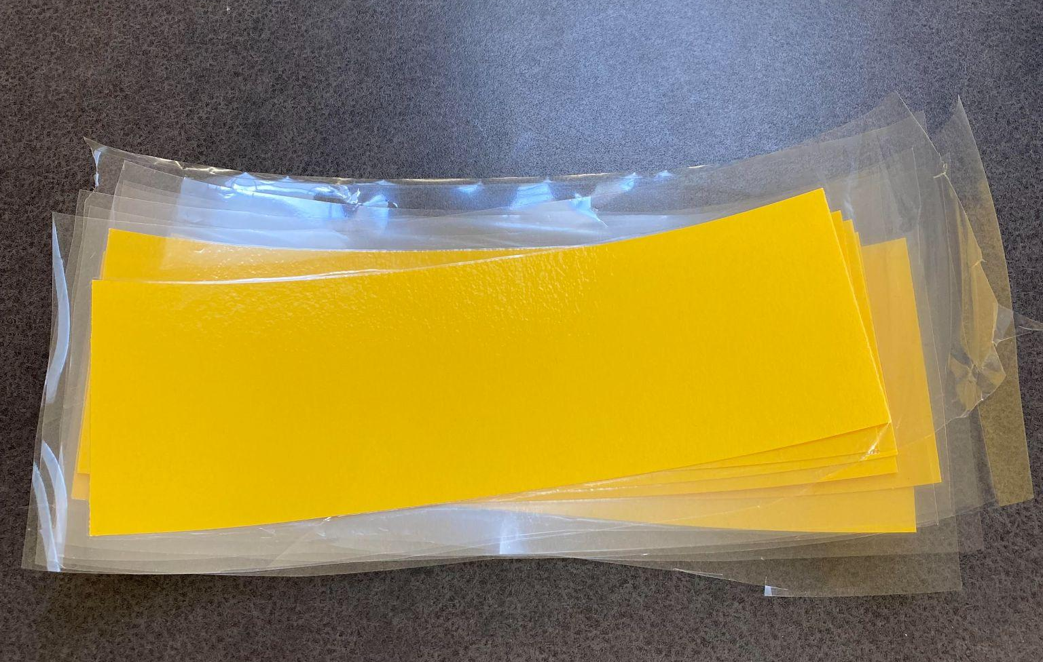
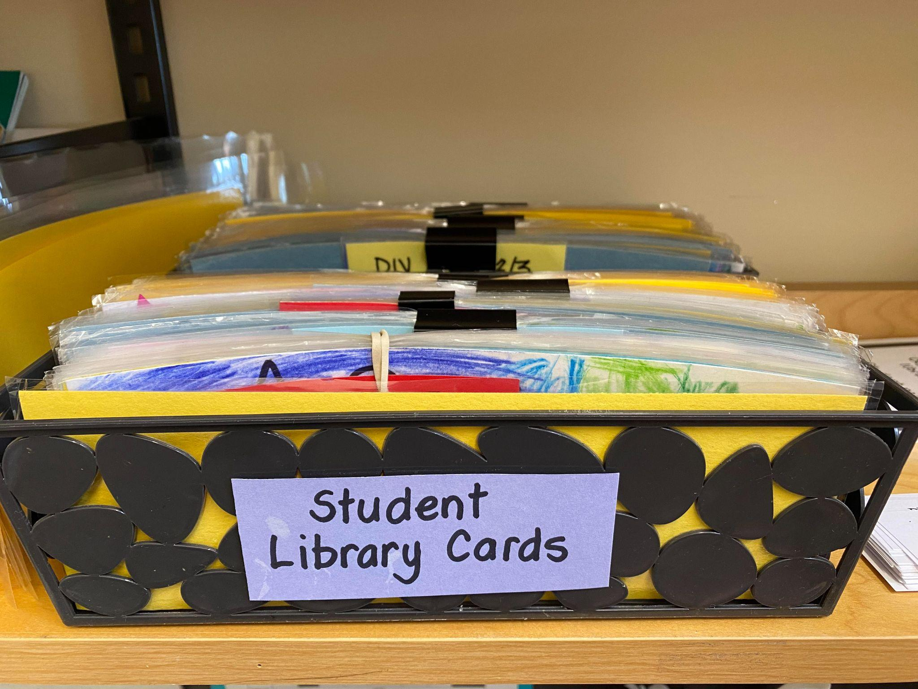
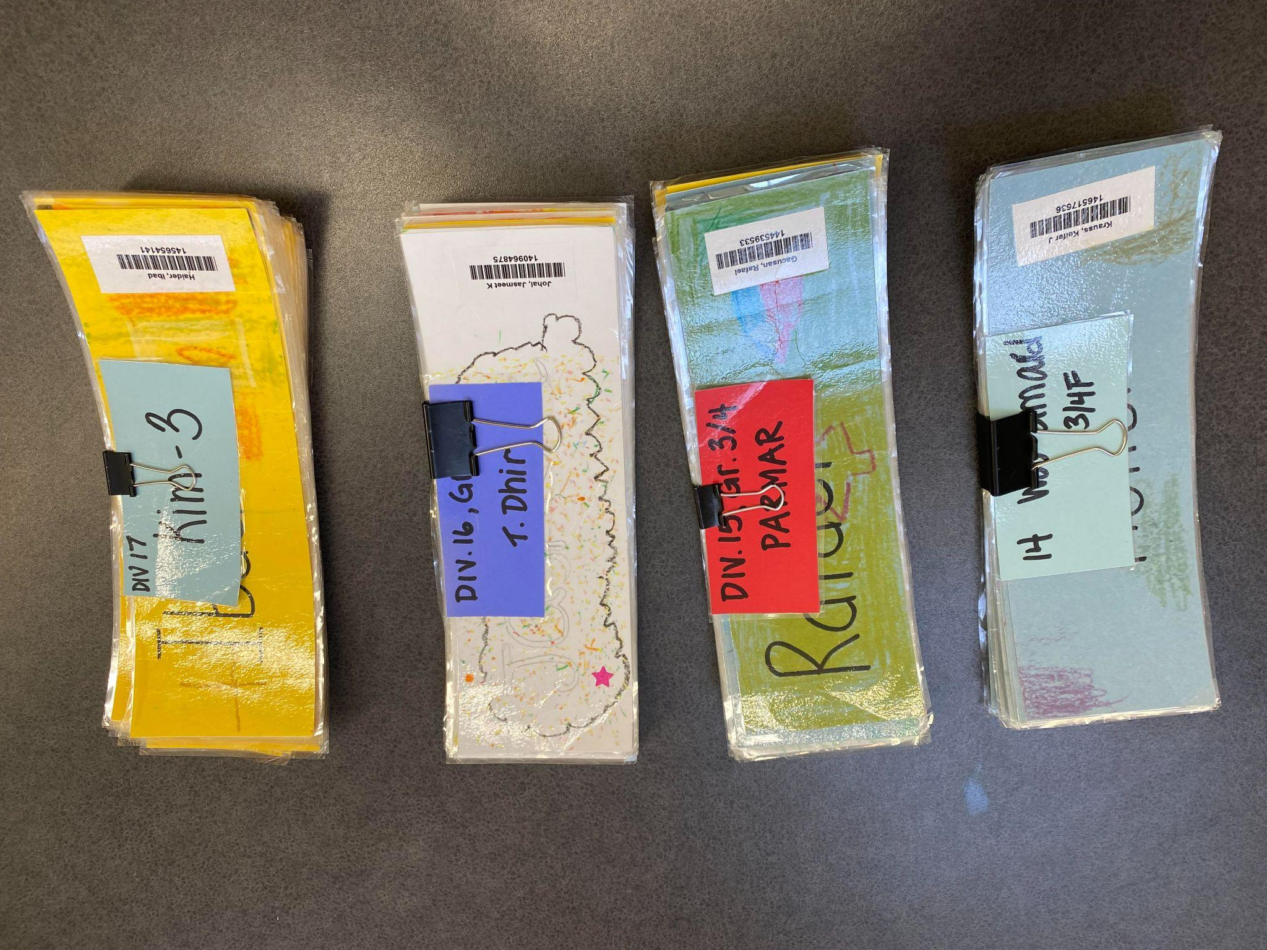
CIRCULATION
Create tags with division number and teacher name. Laminate these while laminating student cards. Clip together and store in a basket on circulation desk. I keep them in numerical order. You could also sort by day of the week.
Notes:
SEL regarding not having to decide who to sit with.

Slide 14
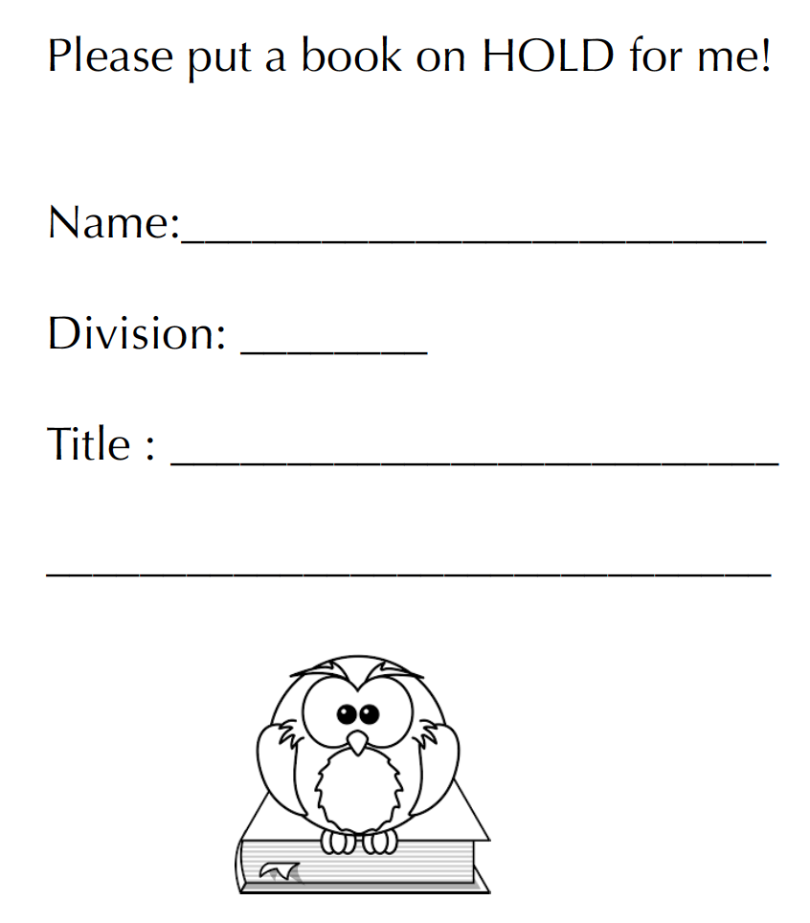
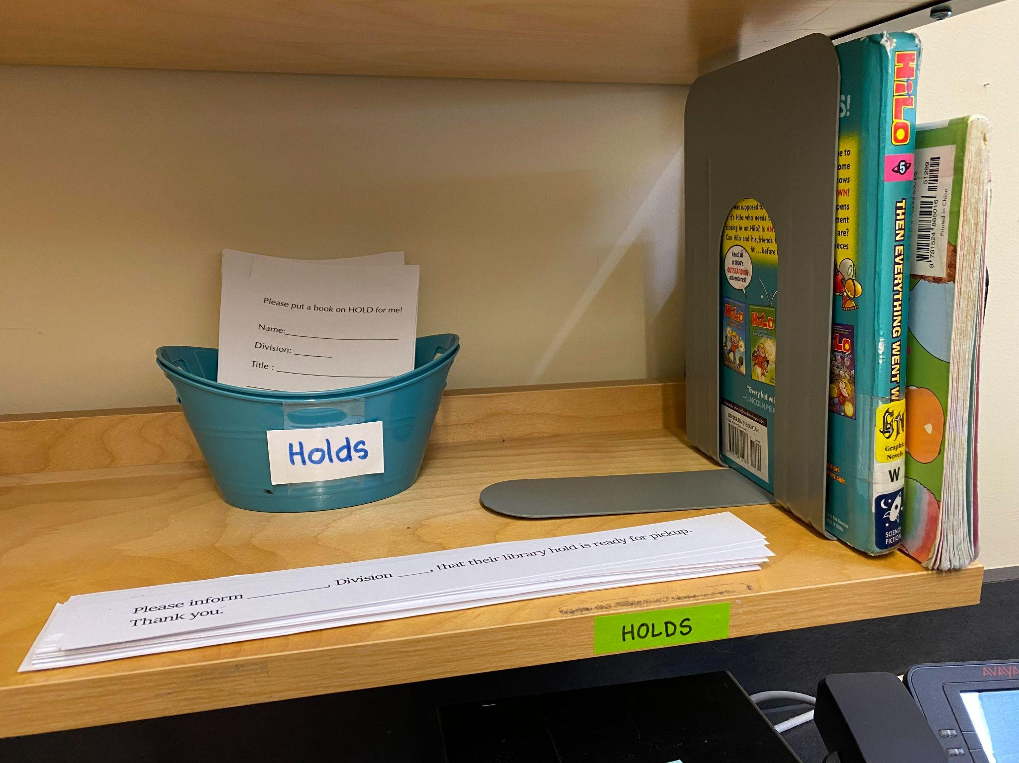
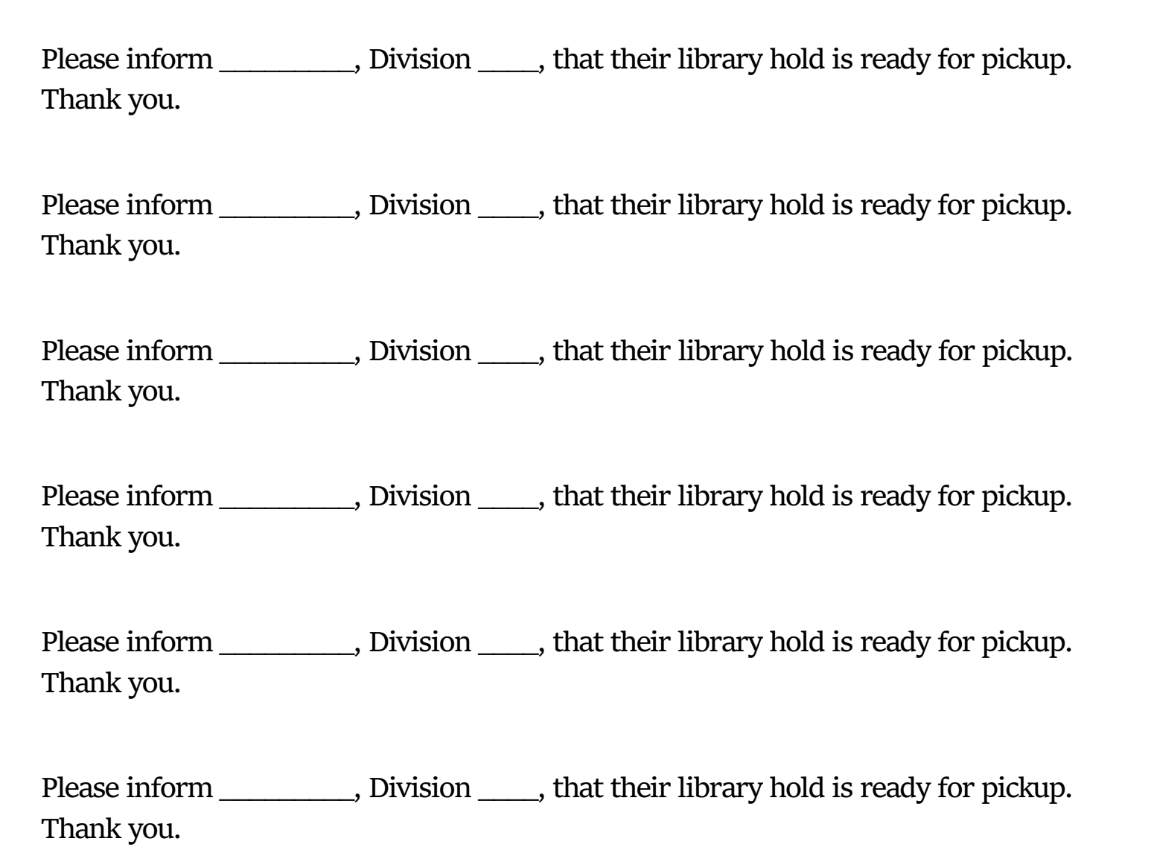
HOLDS
A book is returned and a note pops up to put it on hold for a student.
Put a post-it note on the cover of the book with the student’s name and division.
Put the book on the holds shelf, which is located as close to the circulation computer as possible.
Fill out a “hold is ready” notice and put it in the teacher’s mailbox.
Notes:
Essential to have holds handy. Teachers are given the information about the hold notices at the September staff meeting. Books to buy is another form that I keep next to my circ desk. On it I write whether it is a student or staff request, or whether it is a replacement copy for a damaged book.

Slide 15

MONTHLY THEMES
September
Back to School & Friendship
Rosh Hashanah (Jewish New Year)
Orange Shirt Day/National Day for Truth and Reconciliation
Terry Fox
Dot Day (15th)
Back to School: Introduce students to the school environment, routines, and classroom expectations.
Friendship and Social Skills: Foster positive relationships and teach students about cooperation, sharing, and empathy.
Fall and Harvest: Learn about the changing seasons and the signs of fall, including leaves changing colors and harvest festivals.
Apples
Grandparents Day
Sunflowers
Social Justice
Calendar
Notes:
This list provides a diverse range of themes and holidays allowing for inclusivity and cultural appreciation throughout the academic year. Adding to and referring to this document yearly is part of my long term planning. I choose a theme and a skill for each week (see desk calendar). In my daybook I include whether I am introducing a skill or reviewing it. Because I have been doing this job for so long, I am able to assess which skills a particular class is lacking and adapt as necessary. I also strive to incorporate the school’s focus goals into my program. For example, this year, in order to focus on early literacy, I have added library songs which we read from charts together, as well as games and videos related to learning the alphabet and letter sounds.

Slide 16
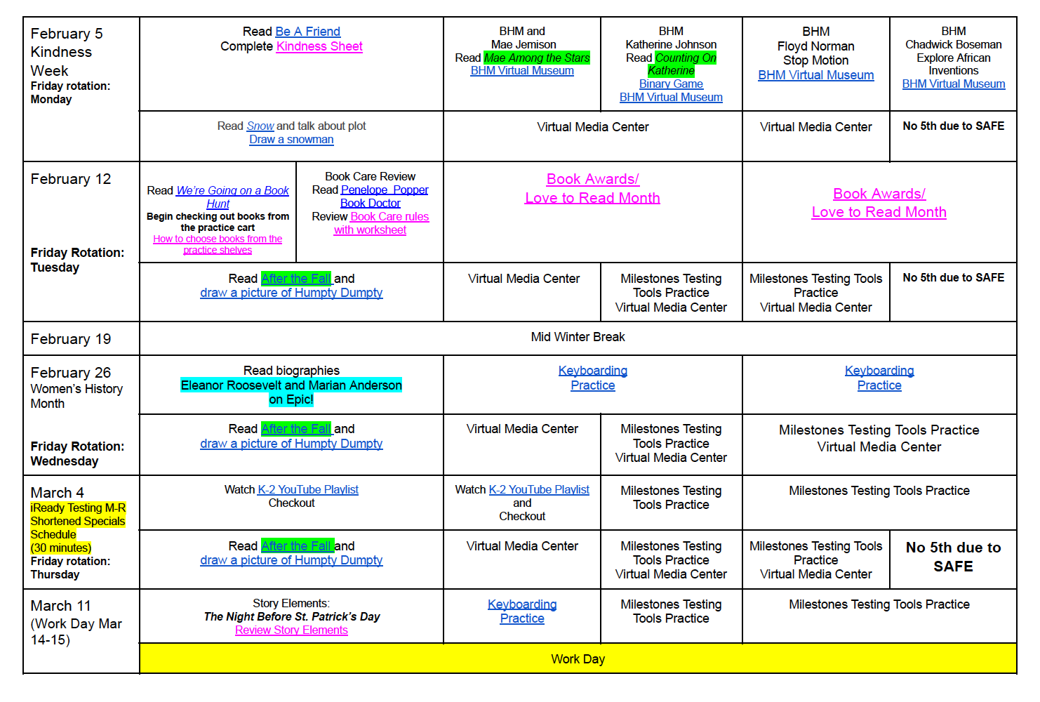


WEEKLY PLANS
Library Curriculums - Wakelet
23-24 Scope and Sequence.pdf
K-5th-Library-Curriculum-Lesson-Plans
Notes:
Detailed weekly lesson plans for an elementary library are available online from a variety of sources. I pick and choose lessons from all of the sites below, depending on the needs of the students. Interwoven into these are issues that arise from the school environment. I prefer to tailor my lessons to support what the teachers are doing in the classrooms, if possible. During informal discussions, I note what teachers are currently working on as well as any challenges they are having and gear my lessons toward these topics. An example would be if a class had been struggling with taking turns or sharing, I would do a read-aloud with this focus and a lesson/activity to reinforce it. Google keywords school library plans. Also check livebinder. More than one right way to do things!

Slide 17
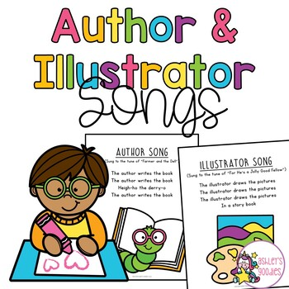
MONTHLY SKILLS
Bring back
song
September: orientation, book care, choosing a just right book, shelf markers
October: Locating books in the library (map), using a hold slip
November: parts of a book, fiction vs nonfiction, text features
December: author and illustrator (author study)
January: genres
February: story elements
March: Internet safety, digital citizenship
April: Poetry, Coding
May: Digital Literacy:website evaluation, illustrator study
June:World Book Online/Research, using an online dictionary, thesaurus
Notes:
Canva, book creator, Sora,other licensable apps your school district subscribes to. Digital citizenship. In primary, I use songs. Talk about “my bonnie lies over the ocean” and how it soothes and quiets classes. They asked to hear it over and over. Jack Hartmann annoying but useful. K routine:

Slide 18
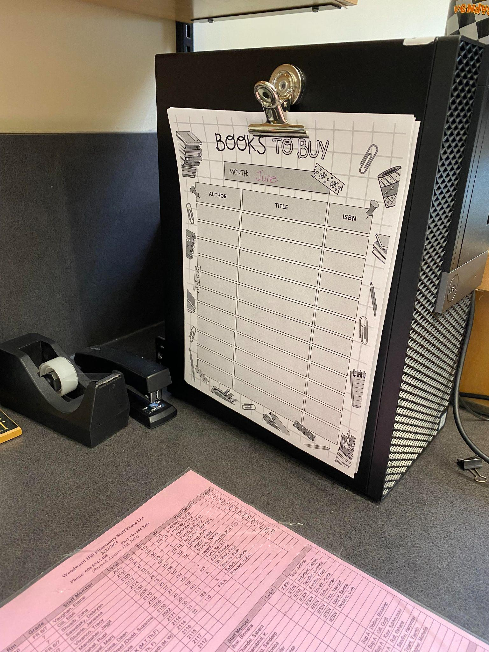
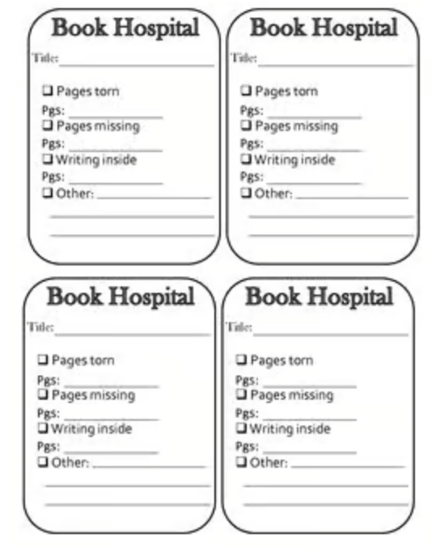
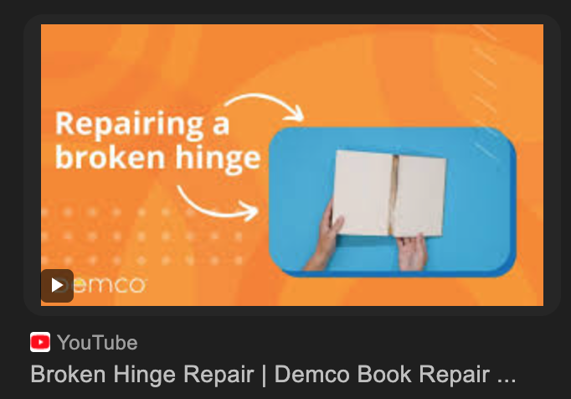
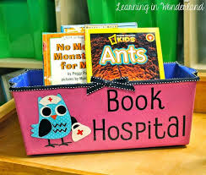
REPAIRS
Notes:
I check books as they are being returned and add them to the book hospital. Some years I use forms such as the one on the right, tucking them in to the appropriate page. I try to do a few repairs each day, so that the pile doesn’t build up into an unmanageable mountain. Mostly I will glue the spines and put elastics around them to dry overnight. I create a patron called Out For Repairs, usually with my school initials and the number 10000. Remember to check them back in before shelving! Talk about TPT here-how I use the free stuff. I cover picture book jackets, but that is a whole other presentation.

Slide 19

TTOC BINDER
Title Page
Class Routines
Class Drop Off Schedule
Before & After School Routines
Opening Routines
Shelving Hints
Prep Schedule
School Map
Medical Alerts
Behaviour Plans
Notes:
Used Canva’s AI generator for the book image. List on the left all has links. Go through them. List on the right, add your own.

Slide 20


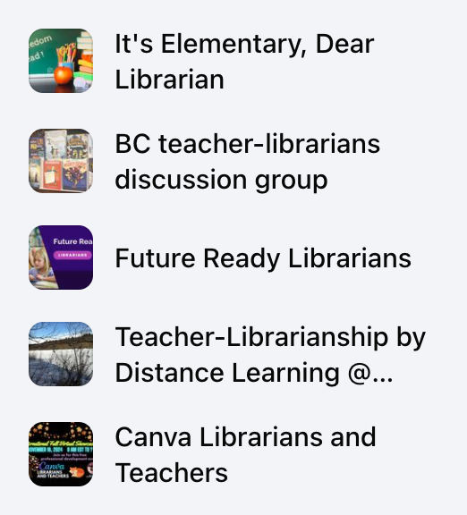


PLN (Personal Learning Network)
Facebook Groups
Bluesky
An option in lieu of Twitter (X).

Slide 21


PLN (Personal Learning Network)
Stay Current
Be Informed

Slide 22

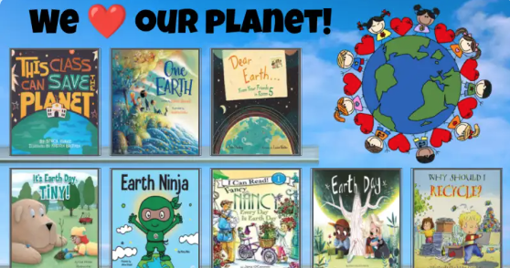
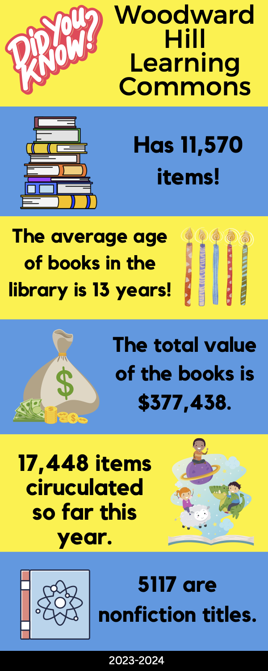

ADVOCACY
Notes:
Use digital libraries. Found on Facebook. Create simple infographics with some stats. Share with admin and school community.

Slide 23
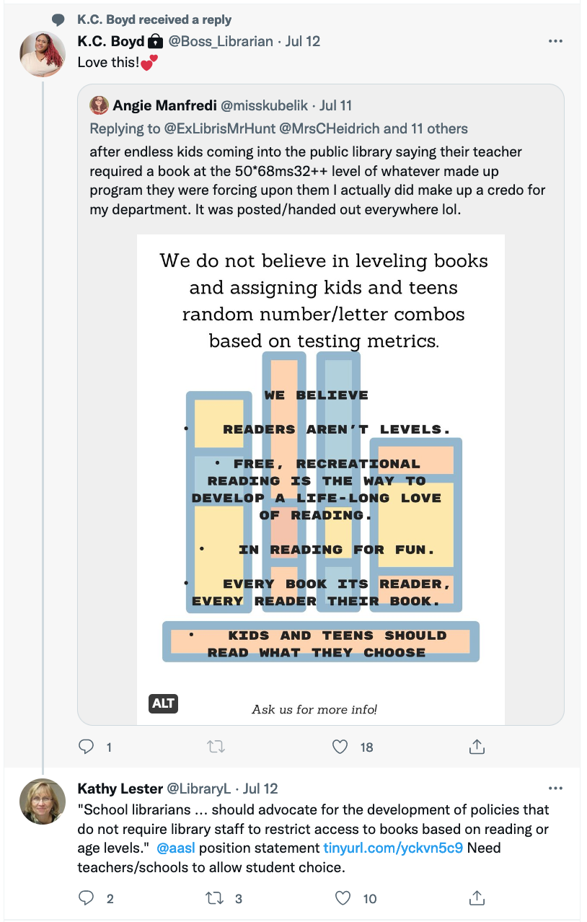
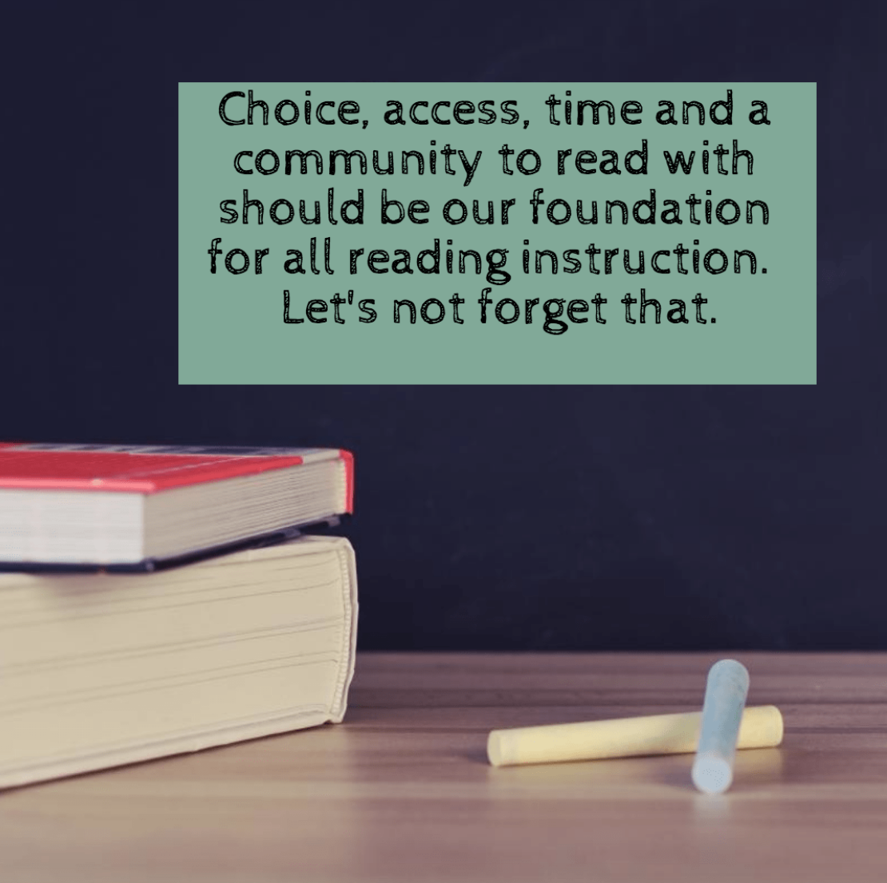
ADVOCACY
Notes:
More people to follow on Facebook. Commentary on book levelling. Talk to colleagues about this!!!

Slide 24
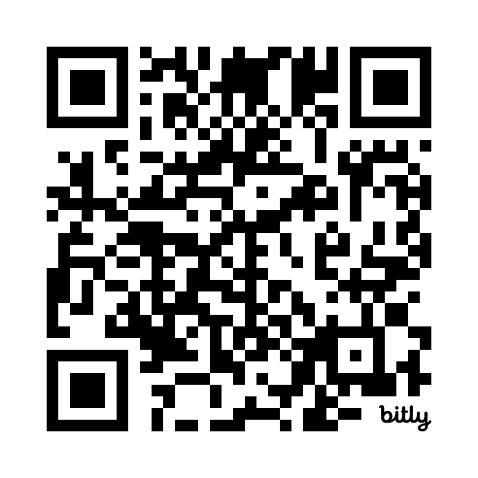
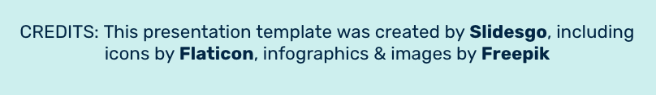
Questions
The link to this google slides deck is:
https://bit.ly/406Z0zS
Contact
lsc122447@gmail.com

