Slide 1

A DAY IN THE LIFE OF A TEACHER- LIBRARIAN

Slide 2
Our School Library Programs:
A fully funded Library program encourages 100% collaboration between the classroom teacher and the teacher-librarian. This ensures that students have access to activities and time in the Library Learning Commons which help them gain valuable transferable skills. This model does not include teacher librarians covering teacher prep time.

Slide 3
WHAT WE DO:
We offer exemplary library programs in all our schools, consisting of rich resource collections, weekly literacy connections, digital literacy skills and maker spaces.

Slide 4
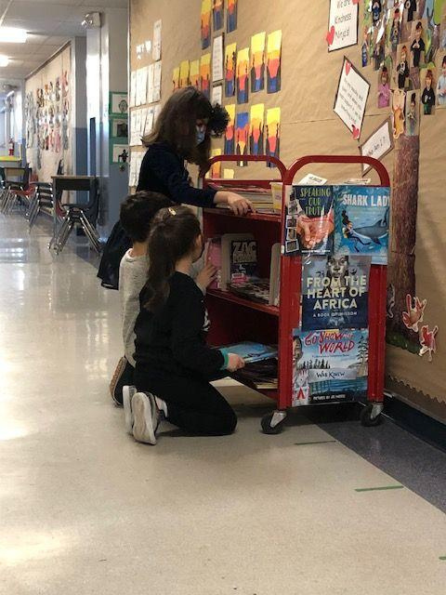
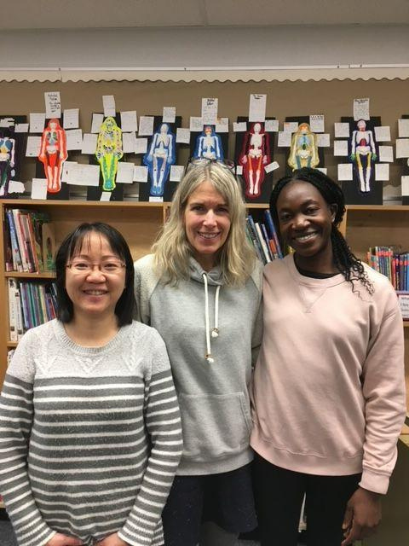
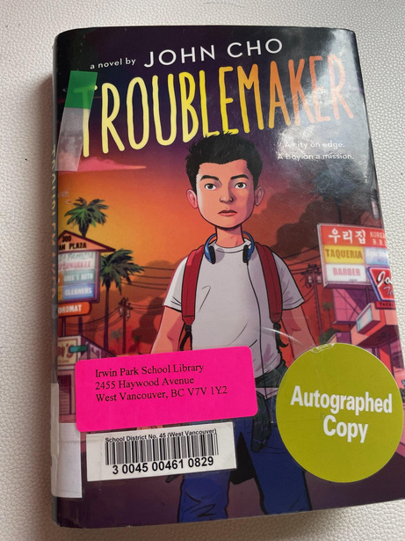
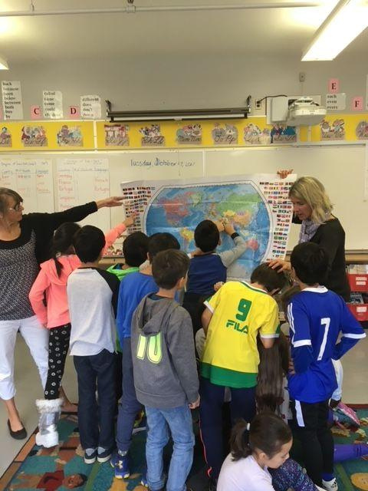
The library is one place at school where students are not judged for their abilities; it is a place to connect and belong. The library is a place to inspire a love of literacy, and build digital literacy skills and lifelong reading habits. Parents are always welcome and part of our extensive volunteer network!
Aw! Thank you very much for your suggestion! I finished this book so quick!
I really enjoyed reading this!
May I keep this book a little more then my husband can read?

Slide 5
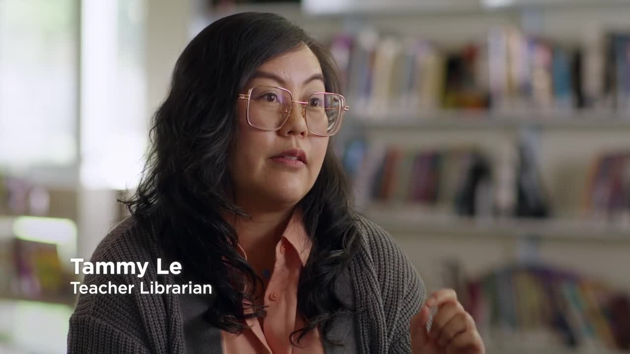
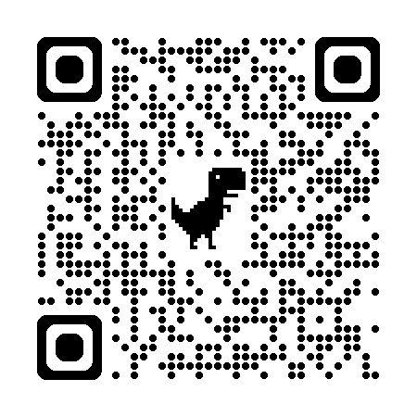
TEACHER SHORTAGE ACROSS THE PROVINCE
Teacher testimonial - Marilyn and Tammy

Slide 6
THE ELEMENTARY TEACHER-LIBRARIAN
A typical school has 200-1000 students
1 Full-Time Equivalent Teacher-Librarian sees 702 students on average
A school can have a Teacher-Librarian 1-5 days a week in the Library Learning Commons
“THANK YOU FOR ALWAYS GETTING ME [JOHAN] AND ARJUN THE BOOKS THAT WE WANT SO WE COULD READ TOGETHER.” - JOHAN

Slide 7
THE ELEMENTARY TEACHER-LIBRARIAN ROLE
The most important part of the job is connecting with each student every week to help create a community of belonging. Important connections are made through:
skills taught in the library
conversations at the reading carpet
brief exchanges at book check out
We focus on literacy skills which increase students’ academic success
The impact of our role has increased in recent years with ELL, LST learning needs of our students and global events (COVID, immigration and refugees).

Slide 8
THE SECONDARY TEACHER-LIBRARIAN
A typical school has 500-2000 students
1 Full-Time Equivalent Teacher-Librarian sees 702 students on average
A school can have 1 to 3 Teacher-Librarians in the Library Learning Commons
“AS A FREQUENT LIBRARY VISITOR, AND A STUDENT WHO WANTS TO BUILD A COMMUNITY, HAVING BOOKS WITH LGBTQ, ETHNIC, OR GENERALLY DIVERSE CHARACTERS, MAKE THE SCHOOL FEEL MORE WELCOMING AND INCLUSIVE. A SAFE SPACE WHERE STUDENTS CAN FEEL REPRESENTED, AND A PLACE WHERE STUDENTS CAN LEARN ABOUT OTHER PEOPLE, CREATES COMMUNITY. LIBRARIES ARE GREAT PLACES TO FORM COMMUNITY AND ARE IMPORTANT SAFE SPACES FOR STUDENTS TO RELAX FROM DAY TO DAY STRESS”.
-Grade 12 student, stəywəte:n̓ Point Grey Secondary School, Vancouver, BC

Slide 9
THE SECONDARY TEACHER-LIBRARIAN ROLE
Teacher-librarians help teachers access resources and build connections to all areas of the curriculum
We collaborate with teachers to team teach research skills and inquiry units
We help foster the love of reading through book talks, literature circles and other literacy activities
We help create a community of acceptance, inclusiveness and belonging by building students’ awareness, tolerance, empathy and understanding

Slide 10
BEHIND THE SCENES:
Managing the resources and learning space to welcome all students and teachers over the course of the week: 10,000+ books, digital resources, technology, writing and maker space supplies, shelving and furniture
Keeping on top of current curriculum, recent publications, diverse books, and digital technology to ensure our space is accessible and inclusive
Managing a budget consisting of funds that range from $6.50 - $20 per student to ensure that purchases reach as many students as possible

Slide 11
MANAGING RESOURCES AND BOOK PROCESSING
Some duties of a teacher-librarian exist outside of the weekly library visits. These tasks take place on-site, online and in the community, and take several hours each week.
Sourcing and purchasing materials to meet the diverse and changing needs of students, teachers and curriculum (online and in-person)
Managing a budget which includes district, school and fundraising sources (online and on-site)
Copy cataloguing, labeling and location of new materials (on-site)
Shelving, facing, and displaying books to organize and advertise resources for curriculum and student interest (on-site)
Monitoring circulation statistics such as tracking overdue books
Book repair, weeding and deletion to maintain a current inventory that reflects best practice with consideration of challenged materials

Slide 12
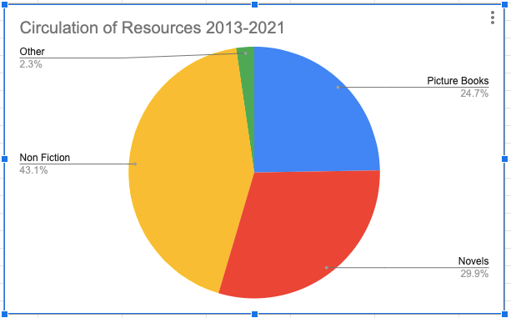
CIRCULATION STATISTICS SHOW THAT STRONG PROGRAMS CULTIVATE STRONG READERS!
Chart shows the circulation of 95, 204 books over 8 years at Hollyburn elementary school, the time a typical student spends from Kindergarten to grade 7. Population of the school averaged 280 students and teachers at this time, resulting in approximately 43 books per person per year!!

Slide 13
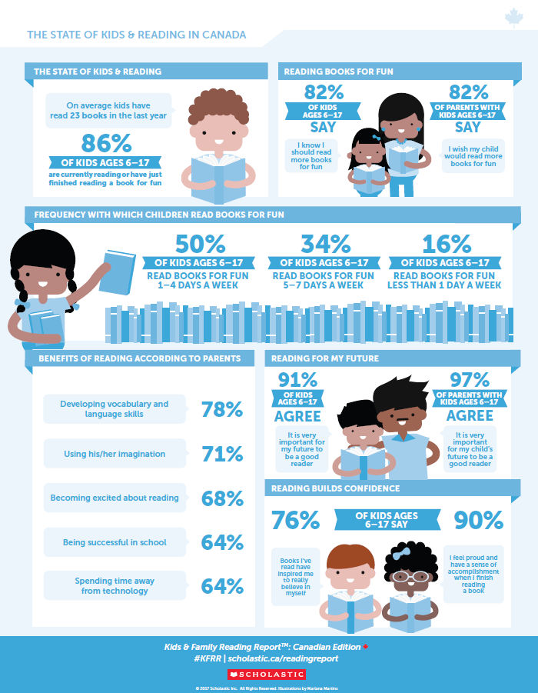
Kids and Family Reading Report
National survey sponsored by Scholastic Canada and managed by YouGov. This is the highlight on the State of Kids and Reading in Canada

Slide 14
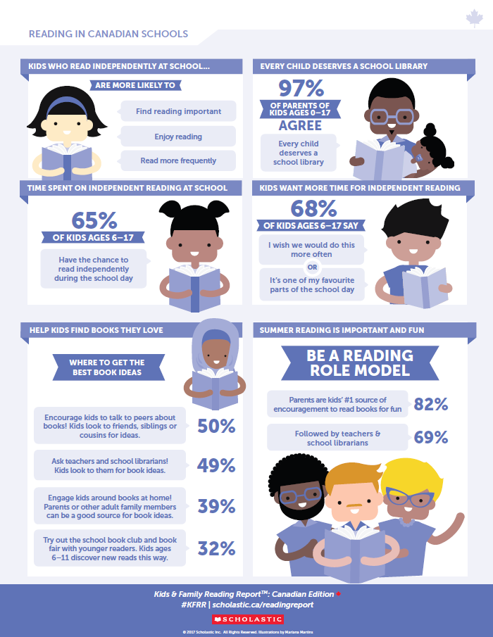
Kids and Family Reading Report
National survey sponsored by Scholastic Canada and managed by YouGov. This infographic highlights reading in Canadian schools

Slide 15
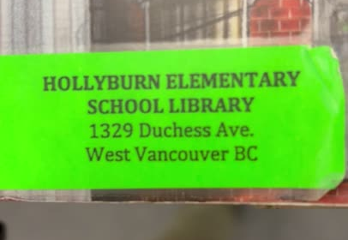
FAMILY FRIDAY!!

Slide 16
A TYPICAL DAY:
fostering a love of literacy for all our students
circulating books to hundreds of readers
supporting the teaching and learning needs of students, teachers, staff and parents
teaching digital literacy and research skills alongside classroom teachers

Slide 17
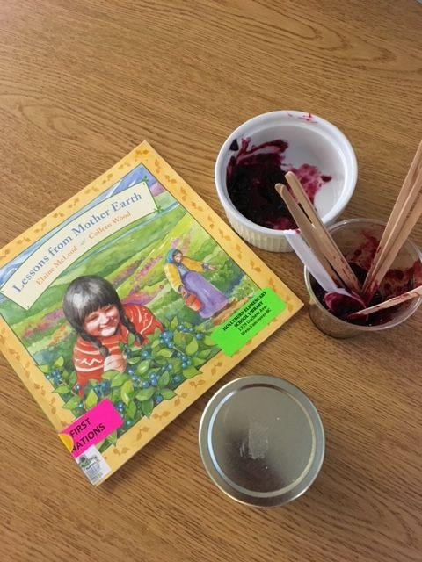
KINDERGARTEN
30 MINUTES • 22 STUDENTS
Ingredients
1 great picture book to read aloud
22 busy bodies and brains to inspire
10 relevant connections to the book
Comfy carpet and reading chair
Preparation
Choose a great fit book that connects to school, community, curriculum, identity, holiday or current event.
Check in with teacher about classroom connections
Display several connected books for students to peruse
Design connection activity with teacher ie. taste test
Be flexible and adaptable to connections the kids make!

Slide 18
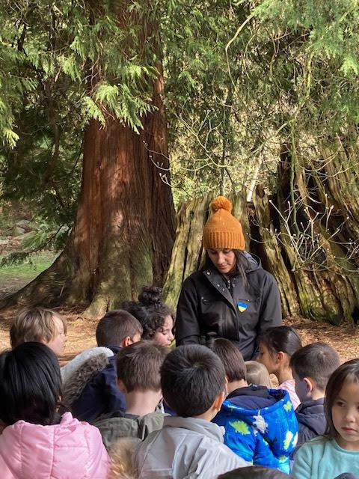
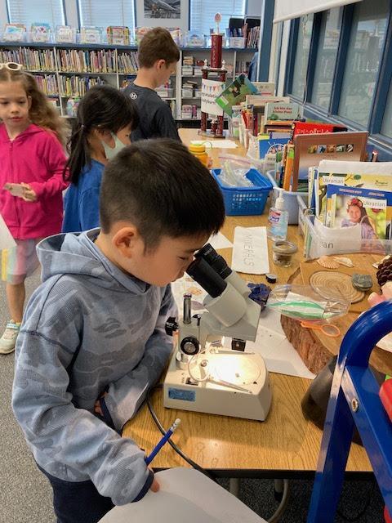

PRIMARY CLASSES
Working with the classroom teacher allows for curricular and community extensions, and meaningful, memorable connections.

Slide 19
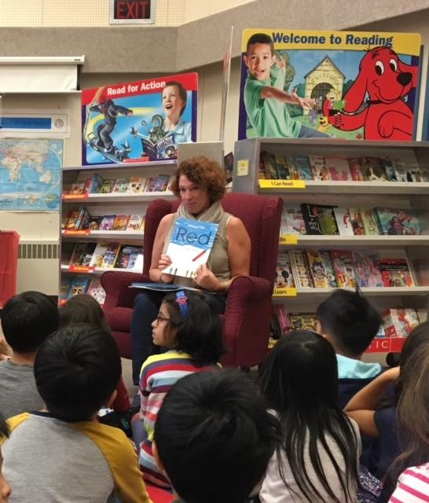
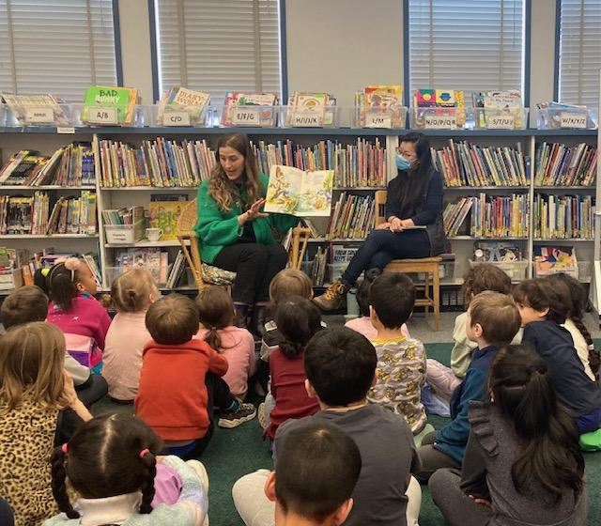
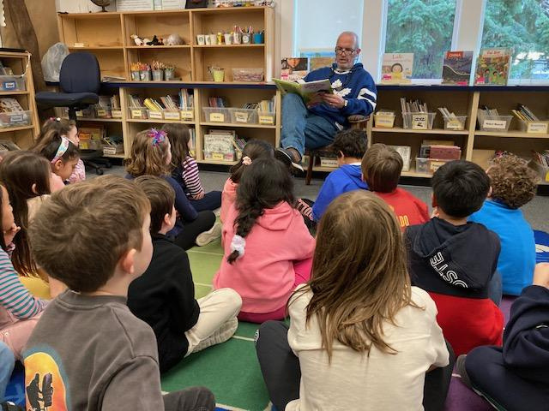

Powerful Presentations (30 minutes with 30+ kids)
The library is a safe, inclusive space. Guest authors, community members and parents connect powerful messages through literacy, art and story. Flexible blocks of time allow scheduling of these events in the library.

Slide 20
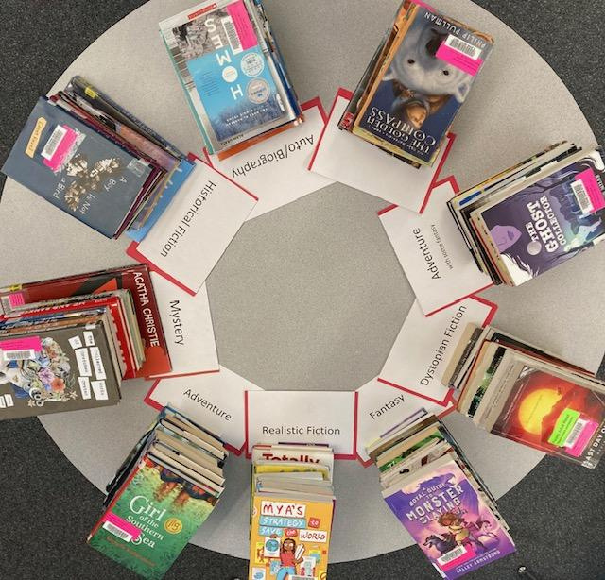
INTERMEDIATE CLASSES
INGREDIENTS
30 novels; 6 different genres
6 tables to spread out novels
genre description cards, paper, pens
PREPARATION
Gather 30 age-appropriate novels and read/skim through them
Check in with teacher about classroom and curricular connections, modify selections as needed
Display books, genre cards
Create flow pattern around tables for students to visit/taste each genre!
Match students to favorite books!
30 MINUTES • 30 STUDENTS

Slide 21
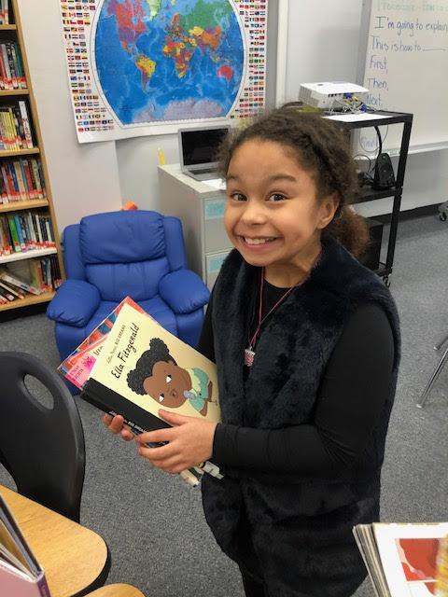
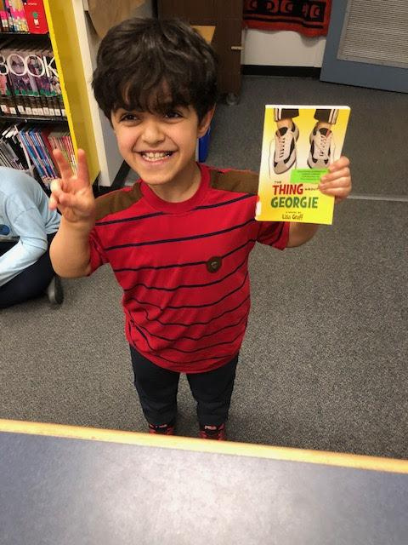
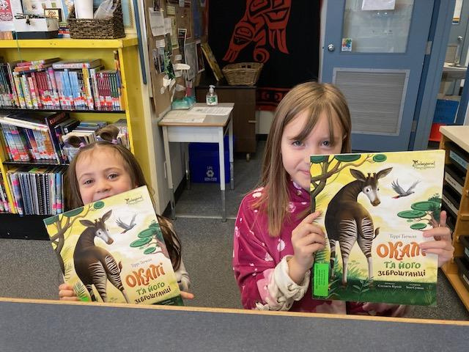

WE NEED DIVERSE BOOKS!
Kids need to see themselves in literature; our collections need to represent our students. The Elementary TL personally connects to K-7 kids in a just-in-time manner, fostering a sense of identity and belonging!

Slide 22
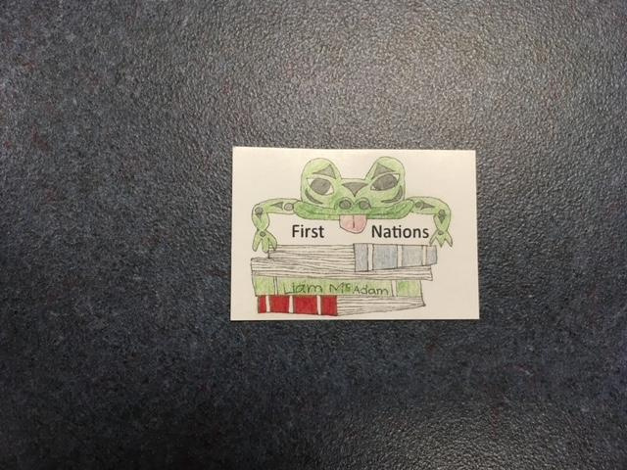
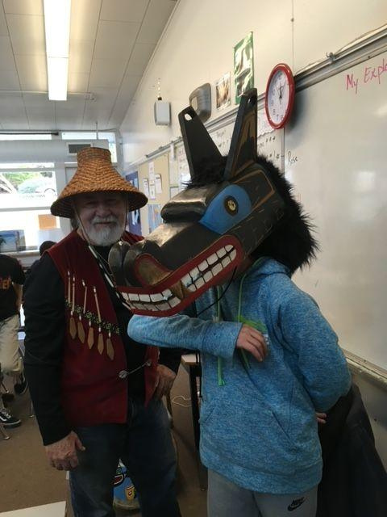
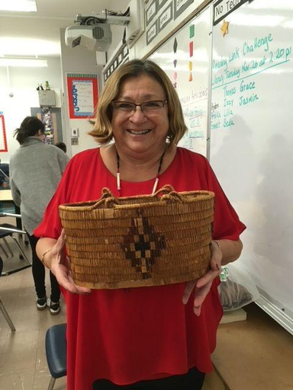
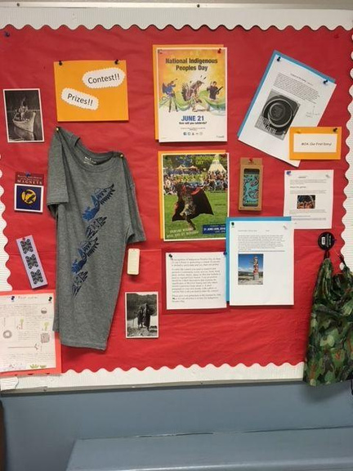
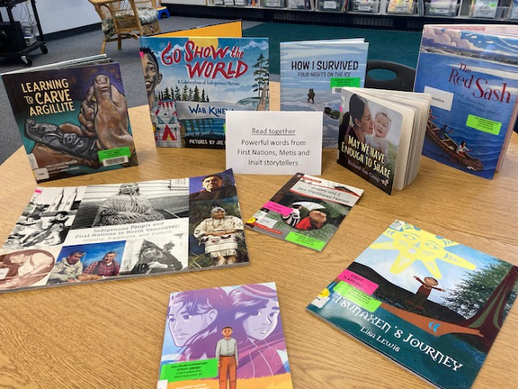
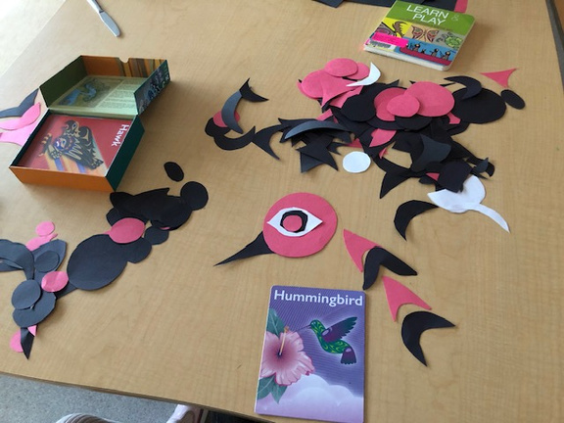
INDIGENOUS EDUCATION
The teacher-librarian can create activities with the classroom teacher, and organize guest visitors who help explore Indigenous Knowledge, Art and Story. Activities promoting Indigenous Peoples Day and First Nations spine labels create a sense of Belonging and Pride.

Slide 23
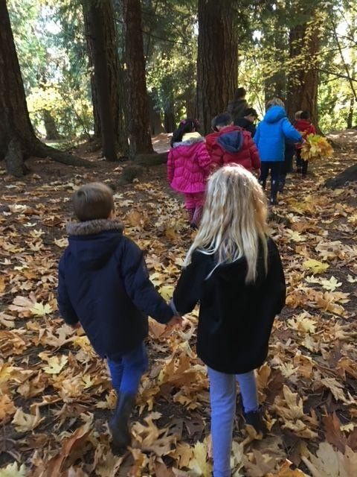
MINDFULNESS EDUCATION AND OUTDOOR LEARNING
Flexible scheduling in the library schedule allows the TL to accompany a class on a walking field trip around the neighbourhood, and then assist with connecting activities the following week. This builds social emotional regulation and fosters a sense of belonging to school and community.

Slide 24
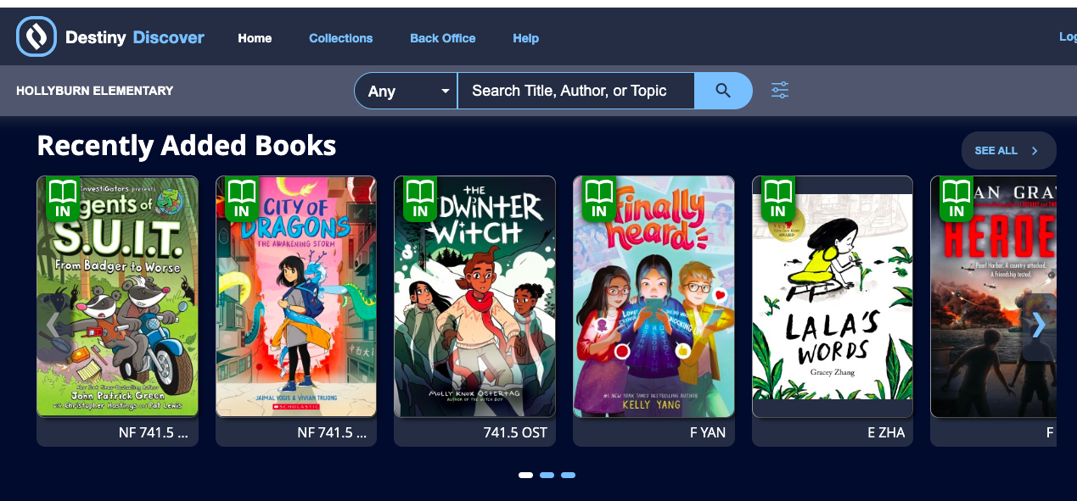
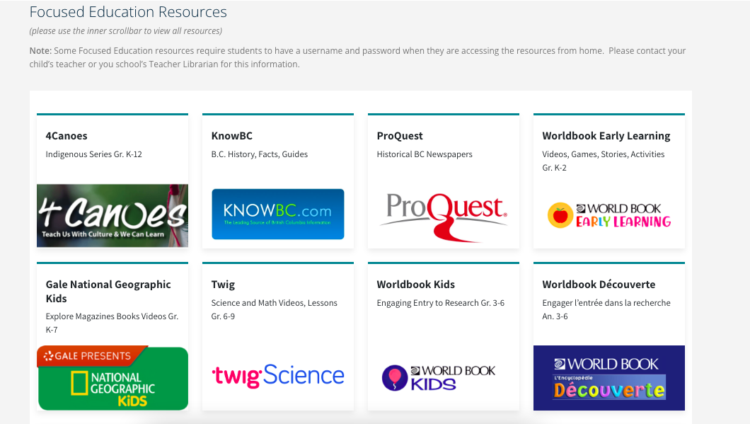
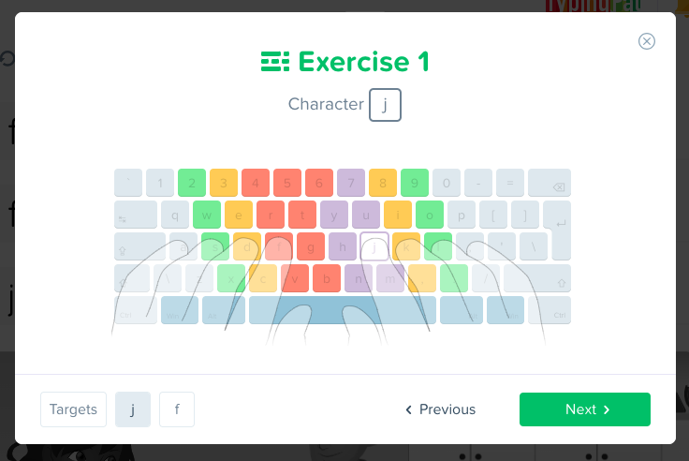
Digital literacy tools to help students navigate their digital world.

Slide 25
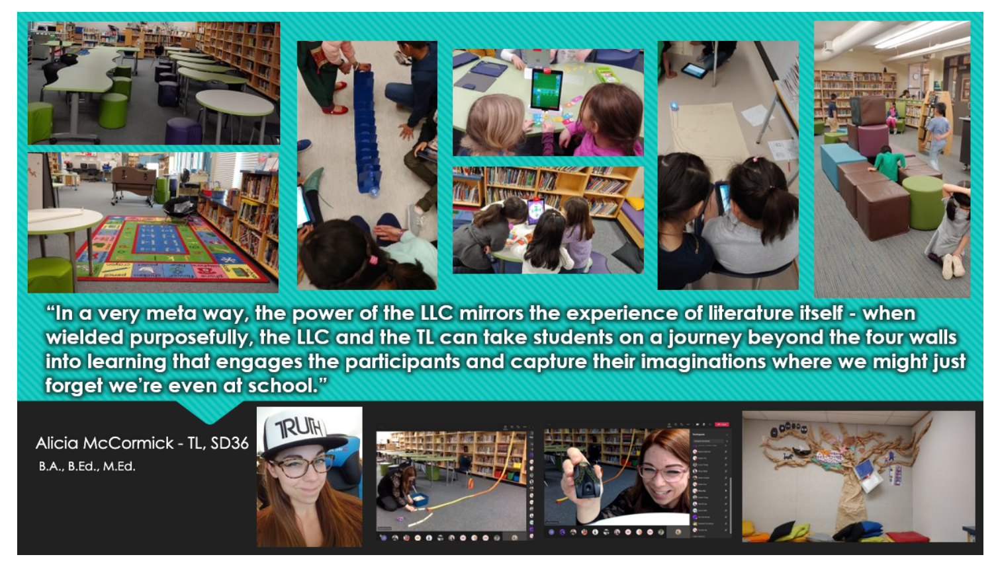

Slide 26
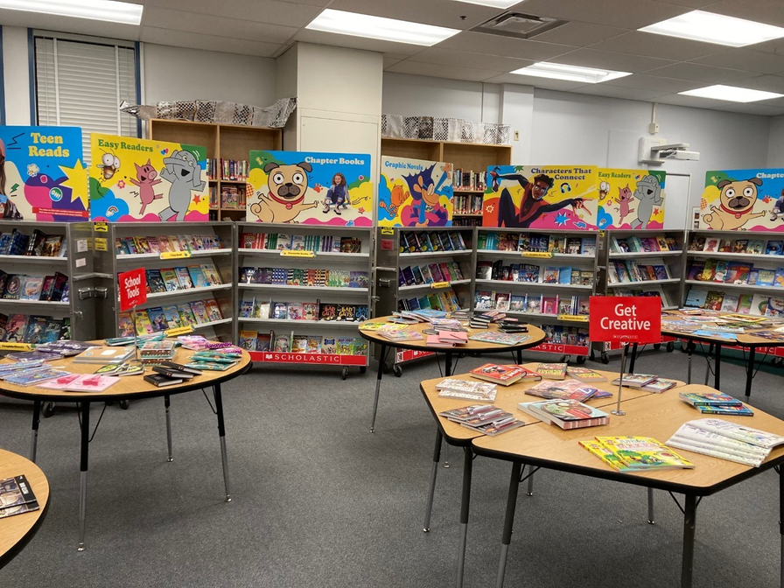
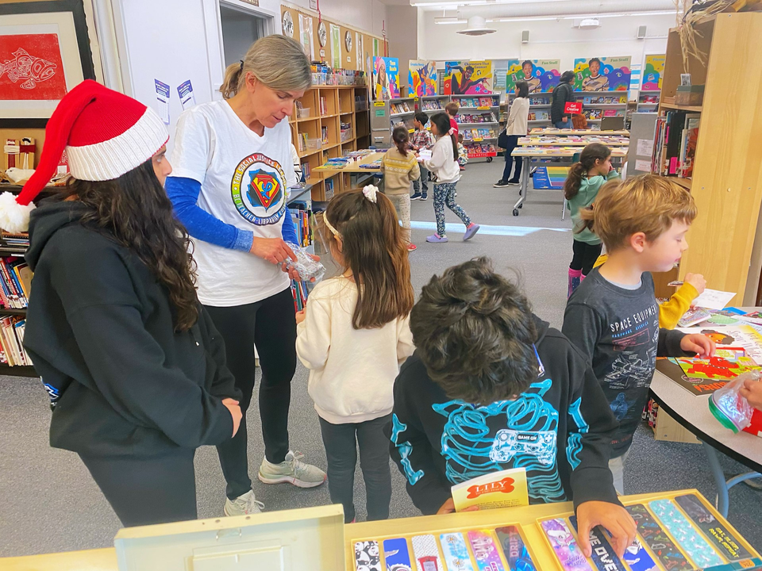
SCHOLASTIC BOOK FAIR - A FAVORITE ANNUAL EVENT!
A Scholastic Book Fair is a big fundraiser, providing thousands of dollars in free books each year. Running a Book Fair includes organizing a volunteer schedule of parents and students, selecting items to be delivered, setting up and packing up items, managing book orders…. and hosting each class!

Slide 27
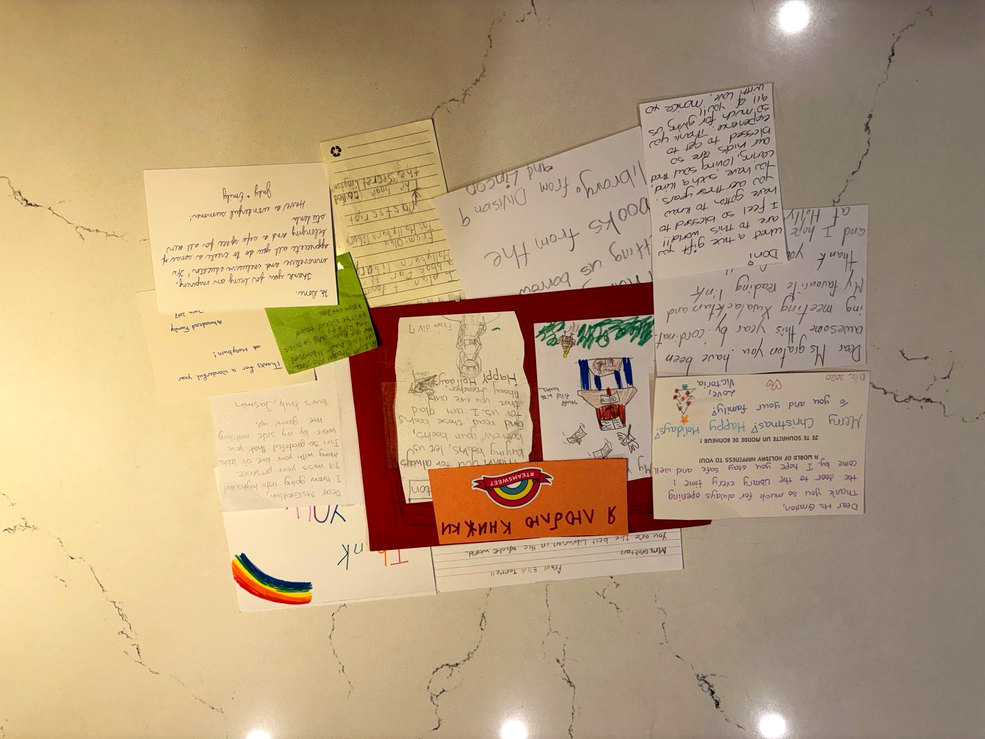
FEELING APPRECIATED!

Slide 28
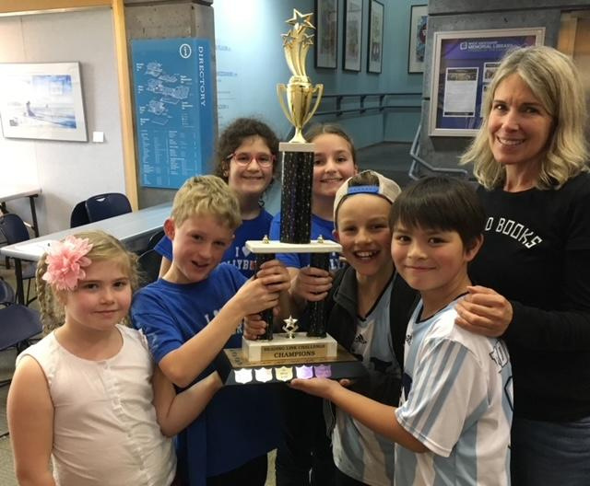

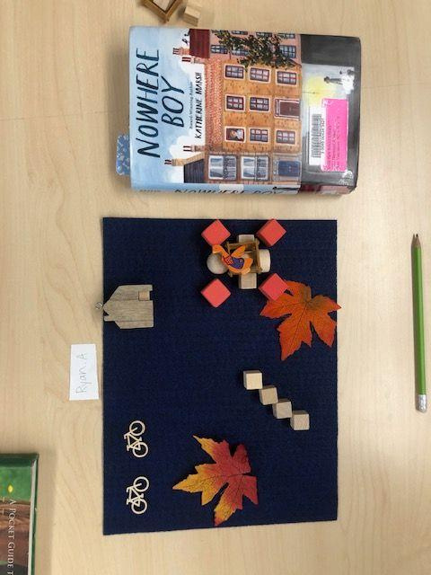
INTERMEDIATE CLASSES
Exploring Literacy, Curriculum and Connections
to Self and Others!
Grade 4/5 Reading Link Challenge Champions!
Grade 6/7 Story Board expressions
Genre taste test

Slide 29
READING PROGRAMS
Schools and districts have developed reading programs that help foster a love of reading and increase literacy. We encourage our students to participate and read together. Titles are selected to appeal to a wide range of readers; which explore ethnic, cultural and other perspectives respectfully and inclusively; and which provide thoughtful and engaging content, reflecting young adult interests.

Slide 30
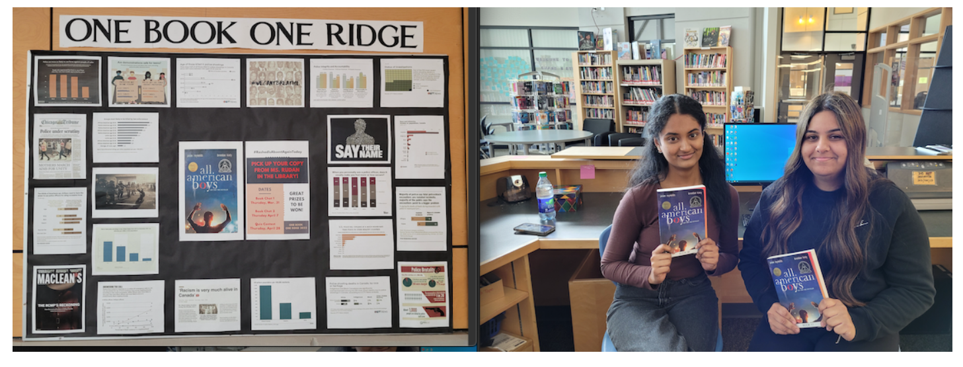

Panorama Ridge has a school wide read called One Book, One Ridge where everyone in the school is encouraged to read. The students can participate in a large trivia contest where their knowledge of the book is tested. The trivia contest is the highlight of the program for most students as the winners can win a variety of prizes! Ultimately, the One Book One Ridge program has been an incredibly rewarding experience. Not only has it increased student engagement in literature outside of the curriculum, but it has also fostered a greater sense of community amongst the staff and students at the school.

Slide 31
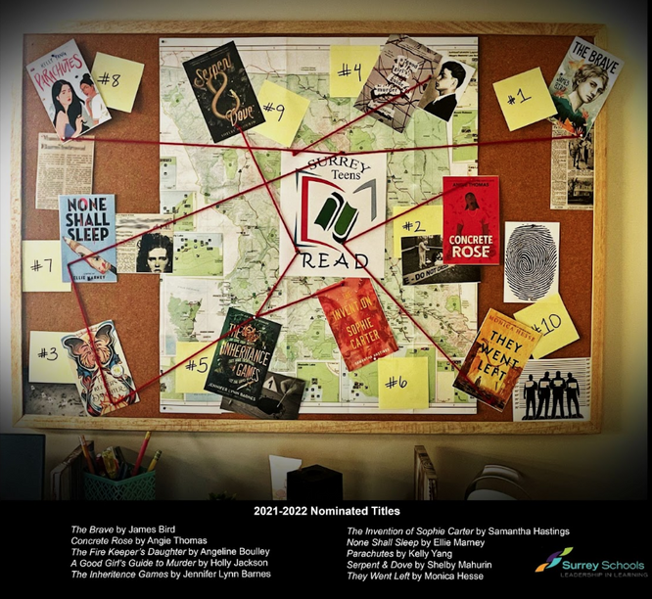

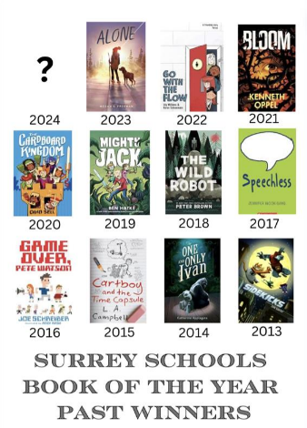
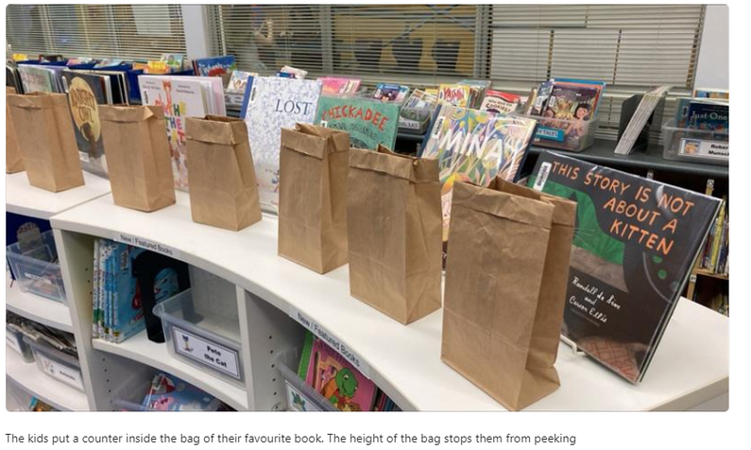
Surrey School District has multiple reading programs ranging from Elementary to Secondary. Students all over the district vote for their favourite!

Slide 32
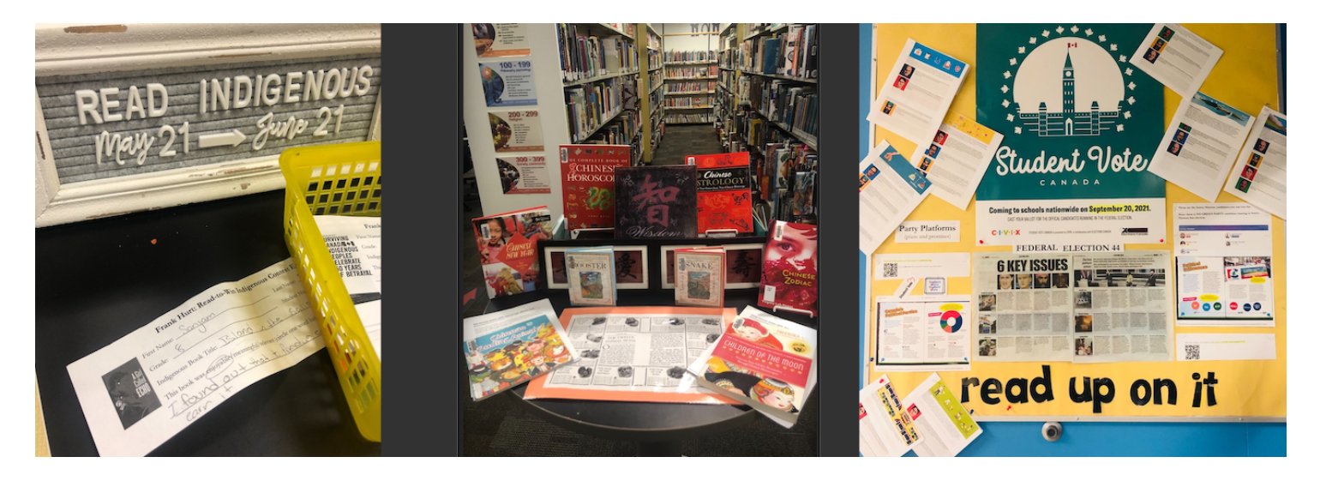
PROMOTING AWARENESS AND INCLUSIVITY
The library at Frank Hurt Secondary plays an integral role in advancing the school goals of building connections and a sense of belonging; supporting the core competencies of communication, thinking, and personal and social identity; and improving attendance.

Slide 33
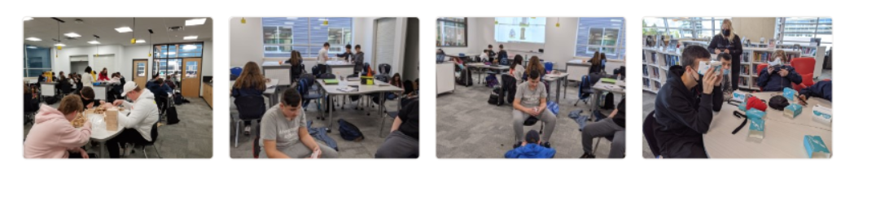
MAKERSPACES: USING DIFFERENT TOOLS TO LEARN
In the Makerspace, students use different tools and manipulatives to learn how to build and collaborate together. Our grade 10 CLE class practiced teamwork and effective communication by using Keva Planks and Lego. Our Social Studies classes used the Makerspace to build paper castles, and Google glasses to check out virtual museums! These are examples of how we use our resources to engage our students and improve student learning.

Slide 34
WHY IS IT CONCERNING WHEN TEACHER-LIBRARIANS COVER TEACHER PREP TIME?
When we provide classroom coverage for teachers’ preparation times, there is no ‘librarian’ available to connect with individual students on reading habits or book choice, so students sign out less books. There is a loss of modeling for classroom teachers because exchanges between the teacher and librarian are compromised. Scheduling teachers’ prep blocks into library time means no flexibility in the week to move classes for a special event such as a book fair, guest author, field trip or to squeeze in library blocks missed due to Professional Development days or Holidays.

Slide 35
“GOOGLE CAN BRING YOU BACK 100,000 ANSWERS. A LIBRARIAN CAN BRING YOU BACK THE RIGHT ONE”
-NEIL GAIMAN, AUTHOR

